Slide 1
From Labeling to Learning: New Culture of Language in Caring for Elders Living with Dementia
Eilon Caspi Ph.D.
Dementia Behavior Consulting LLC
September 19, 2016 @ Mary t

Slide 2
Auguste Deter 1901
Notes:
Share Kitwood’s story (directly from the printed 1-page):
“A day center was approached by an agency concerned to promote awareness about Alzheimer’s disease and similar conditions. ‘Could the day center provide some photographs of clients, to be used for publicity purposes?’ Permission was sought and granted; the photographs were duly taken and sent. The agency, however, rejected them, on the ground that the clients did not show the disturbed and agonized characteristics that people with dementia ‘ought’ to show, and which would be expected to arouse public concern. The failure of the photographic exercise, from the standpoint of the agency, was a measure of the success of the day center from the standpoint of the clients. Here was a place where men and women with dementia were continuing to live in a world of persons, and not being downgraded into carriers of an organic brain disease.” – Prof. Tom Kitwood, in a book chapter “On Being a Person” in his groundbreaking book: Dementia Reconsidered: The Person Comes First.

Slide 3
Biomedical / Psychiatric Model
vs.
Person-directed Practices

Slide 4
Person-centered care
vs.
Person-directed care
Notes:
Practices in “person-centered care” represent a substantial improvement on previous biomedical approaches.
However, leading educators such Dr. Allen Power suggest…
Person-directed care is a preferable term. The reason is…
In person-centered care, we professionals, researchers, and even family members assume what is good for the person.
In person-directed care, we actively seek the opinion and input of the person at all stages of the disease…

Slide 5
Major Barriers for Change
“Ageism”
“The stereotypes to which people are subjected to when they grow old” – Dr. Robert Butler
“Discrimination based on age”
– American Medical Association
Misconceptions about people living with dementia (Radio interview – My Talk 107.1; March 20 2016):
http://www.symphonyseniorhomecare.com/wp-content/uploads/2016/04/WR032016-11.mp3
Notes:
“Ageism” = In 1968 Dr. Robert Butler coined the term to “identify the stereotypes to which people are subjected when they grow old” [Encyclopedia of Ageism]
+
“Discrimination based on age is Ageism.” [Source: AMA; American Medical Association]
=>
“Freedom from prejudice on the basis of age should be one civil right that is embraced by all.” Dr. Robert Butler, in Foreward to Encyclopedia of Ageism (2005)
Misconceptions about people living with dementia: Radio interview.
||| [My Talk 107.1 – With Jim Miley & Peter Schwartz from Symphony Senior Home Care. Radio interview (45 minutes) on 3.20.16. Host: Twila Dang. St. Paul. MN.]
Examples of 4 misconceptions about PwD:
That they can’t be meaningfully engaged; 2. Can’t experience joy; 3. That they can’t communicate with others;
4. The main reason for their behavioral expressions is their brain disease.
Widely held negative images and stereotypes in society. There’s so much fear out there…when with the right care skills and supports, many PwD can live well psychologically and have fairly good QoL well into the later stages of the disease... It is often the family members who struggle tremendously with losing their loved ones gradually…
In my 22 years in the aging field, I find that the majority of the problems or “problems” re to elders and those living with dementia have to do with Ageist perceptions and misconceptions about people living with dementia.

Slide 6
Notes:
Based on years of observations, the late Prof. Kitwood from the UK identified the main psychological needs of PwD:
The need for psychological comfort; continued sense of identity; the need to be engaged purposely and meaningfully; the need to feel included…to belong to a group one cares about; the need to be with people one trusts and feel good with; and the central need we all share to love and to be loved!
+
When these needs are not met, they often lead to tremendous frustration and “aggressive” behaviors….
Other domains of needs include physiological, medical, functional, social, cultural, and spiritual…-- because most of you are psychologists and psychiatrists I thought to focus on these needs.
In his recent book, Dementia Beyond Disease, Dr. Allen Power, argues that when 7 domains of well-being of persons with dementia are supported, this reduces the likelihood that expressive behaviors including physically reactive ones will occur. The domains build upon Kitwood’s domains of psychological needs.
= Dr. Power domains include: Identity, Connectedness, Security, Autonomy, Meaning, Growth, & Joy.

Slide 7
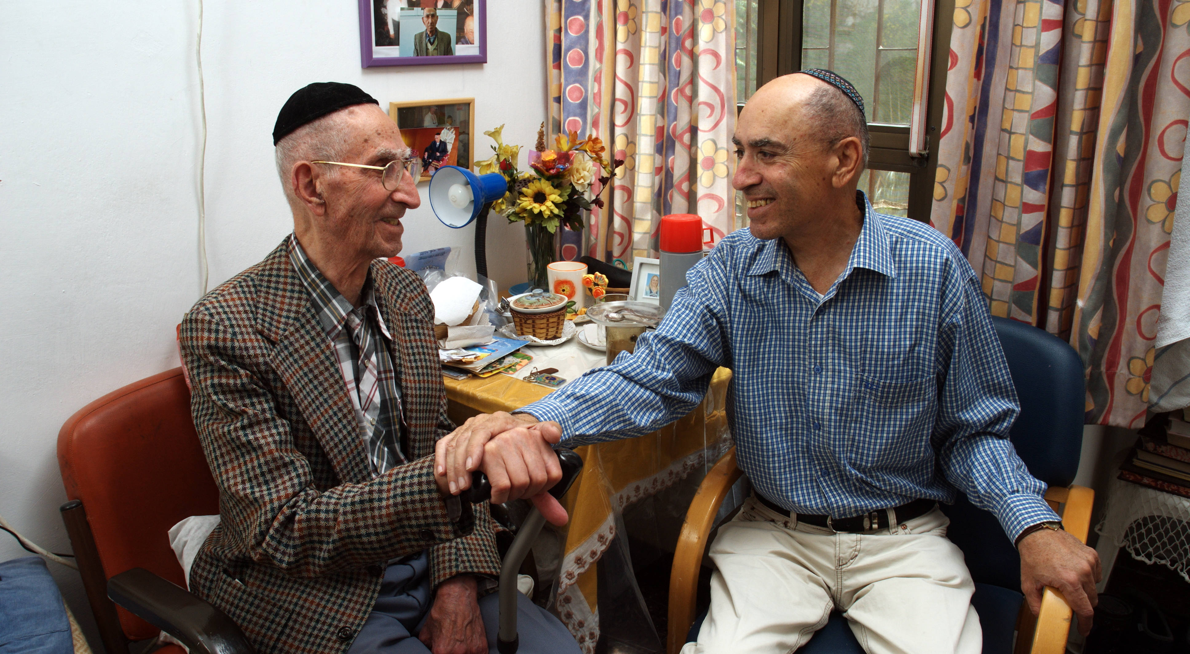
Close Trusting Relationship
Permission to use this image was received from Ofir Ben Natan, ESHEL, Israel
Notes:
By far…the single most important asset we can have when interacting with residents with dementia and when trying to prevent their aggressive behaviors…
Hard work to build and maintain, & easily destroyed. When we are successful in building it, the resident is much more likely to cooperate with us...
[Source: Norton et al. (2009). Caregiver-recipient closeness and symptom progression in Alzheimer’s disease. The Cache County Dementia Progression Study. Journals of Gerontology: Psychological Sciences, 64B(5), 560-568.]
…

Slide 8
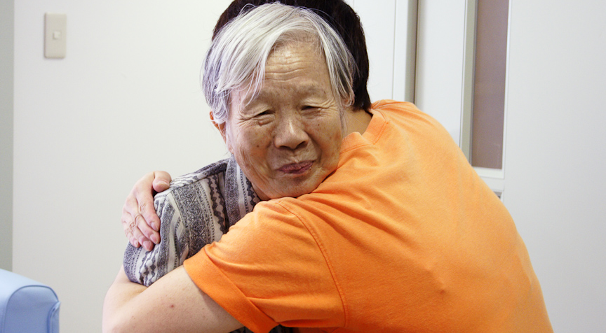
Close Trusting Relationship
Permission to use the image received from Dr. Cathy Greenblat,
author of the book: Love, Loss, & Laughter: Seeing Alzheimer’s Differently (2011)
Notes:
Every person…even those in late stages of dementia understand the meaning of a hug!!!
+
Though not every person is comfortable with these expressions of affection & warmth…

Slide 9
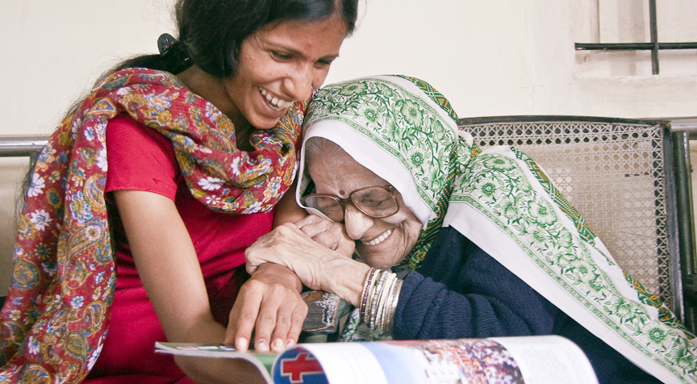
Close Trusting Relationship
Permission to use the image received from Dr. Cathy Greenblat,
author of the book: Love, Loss, & Laughter: Seeing Alzheimer’s Differently (2011)
Notes:
We know from years of practice and research that with the right supports persons with dementia can have positive experiences despite cognitive decline…
[UNTIL HERE]
|||| [Dozens of pictures from different countries in the fabulous book: Love, Loss, & Laughter: Seeing Alzheimer’s differently -- by Dr. Cathy Greenblat]

Slide 10
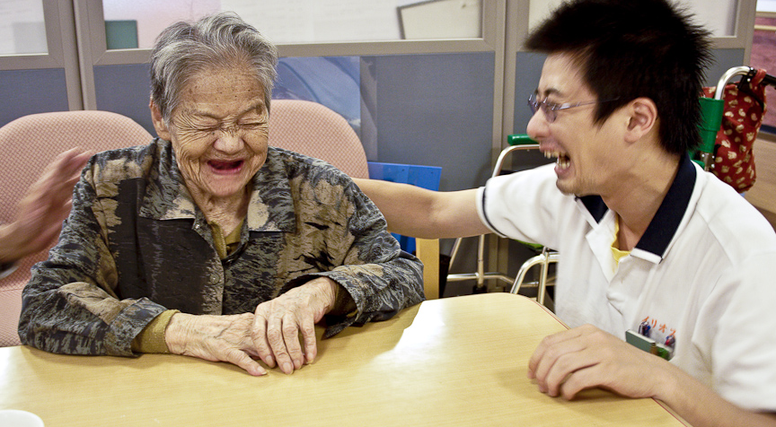
Close Trusting Relationship
Permission to use the image received from Dr. Cathy Greenblat,
author of the book: Love, Loss, & Laughter: Seeing Alzheimer’s Differently (2011)
Notes:
A resident with early-stage AD in my study said one day: “Humor is the only prescription that never fails.”
Stand up comedy – Study by Stevens (2011) – showed improvement in sociability, communication, and self-esteem…
Going to the circus – such as in innovative program by Dr. John Zeisel…Hearthstone…in Boston…

Slide 11
Close Trusting Relationship
Closer relationship b/w family care partners and PwD is associated with slower cognitive and functional decline (esp. spouses) (Norton et al. 2009)
Better relationships are associated with lower levels of behavioral expressions (Spruytte et al. 2002)
Collaborative approach is more effective in meeting the person’s needs…
“Authentic Partnership” – Dr. Sherry Dupuis
“Nothing About Us without Us”
Notes:
By collaborative approach…I mean…when you look closely at the interaction with the person what you see is a real partnership and reciprocity!
Contrary to common belief, the need for close relationships actually increases in many with the disease…
However…due to stigma and lack of awareness, many friends distance themselves from the person…which can be heartbreaking!
[UNTIL HERE]
…
Zgola, author of the excellent book Care that works: A relationship approach, tells us that trust is the single most important asset we have in caring for persons with dementia… Hard to build and maintain…easy to destroy…
Spruytte et al. (2002) Study – Behaviors in the study included agitation, aggression, wandering, depression, irritability, and shouting…
[Source: Spruytte et al. (2002). The quality of the caregiving relationship in informal care for older adults with dementia and chronic psychiatric patients. Psychology & Psychotherapy, 75, 295-3011.]
…
Norton et al. (2009) study
= Relationship Closeness Scale (six-item instrument): Care recipient (CR) always understands what I value in life; My relationship with CR is close; CR makes me feel like a special person; CR and I can always discuss things together; REVERSE ORDER ITEMS: CR is often critical of me; My relative makes me feel that whatever I do for him/her, it is not enough.
[Many behaviors may be related to problems in the caregiving relationship (Lyman, 1989)]
Sherry Dupuis [SOUNDS: DOOP-WEE ] and her colleagues at MAREP as was described in their fabulous 2011 article Moving beyond patient and client approaches: Mobilizing "Authentic Partnership" in dementia care, support, and services...

Slide 12
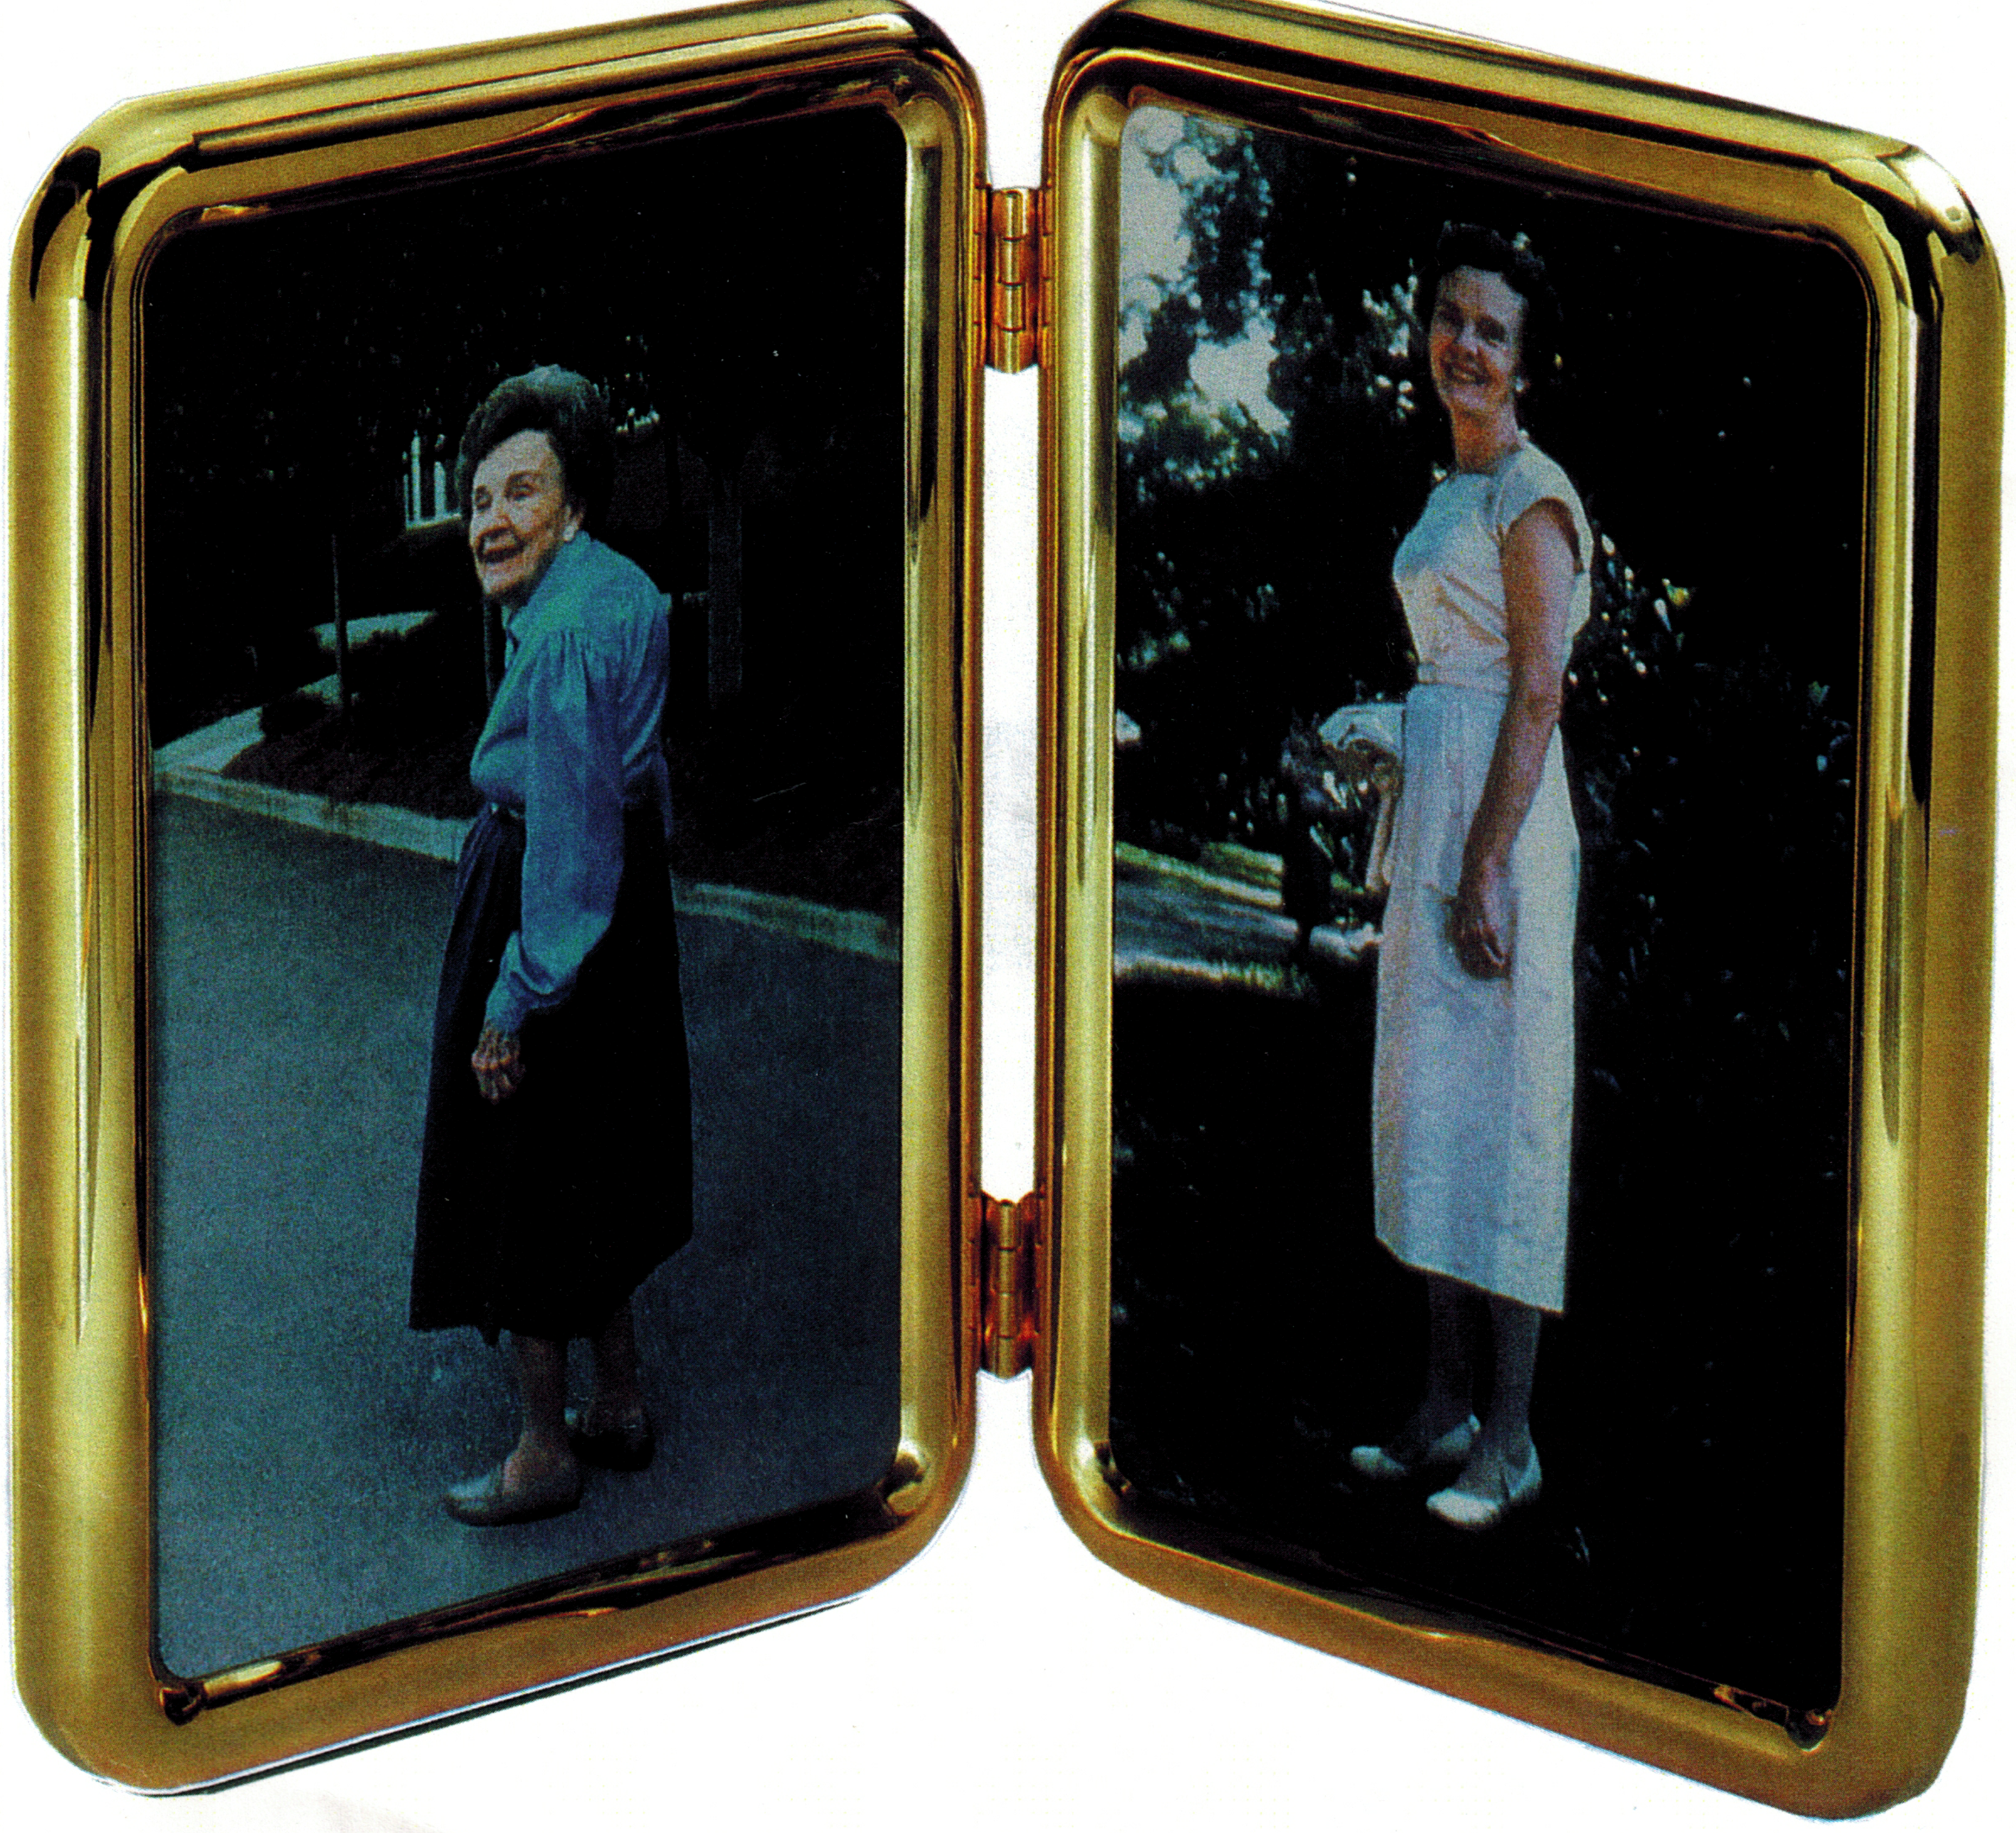
Know the Resident’s Early Life History
20 reasons can be found at: http://tinyurl.com/zmct8lt
Notes:
40% of us are estimated to live in a NH at some point in our lives? [Pause] What would you want your care staff to know about your life history?
Building close trusting relationships with residents and knowing their life history helps:
Have a meaningful conversation (such as by tapping into the treasure chamber of long-term memories).
3. Plan engagement in meaningful activities
4. Identify remote triggers from the distant past. There’s a strong link b/w early life trauma & behaviors in the present. Enables us to be more empathic and avoid those triggers.
5. It can make a big difference during aggressive altercations. It is amazing to see how the resident will not listen to one staff member but he/she will to another…
The way we relate to the resident during non-aggressive times influences the level of his cooperation during aggressive episodes
6. Preserve their personhood and identity.
Find out what makes the resident become angry or lose temper with others = [HANDOUT] = Series of questions for family members prior to admission…
…
Types of info to collect include identity, pre-morbid and current personality characteristics (e.g., temperament; agreeableness), values, beliefs, coping style, daily routine, likes and dislikes, preferences, interests, passions, favorite activities, cultural and spiritual background, fears, and history of aggression.
The Locksmith position (UK). Brooker & Wooley (2007), Bradford Dementia Group, University of Bradford, UK.
[Next slide = Case Example (Tulips)]

Slide 13
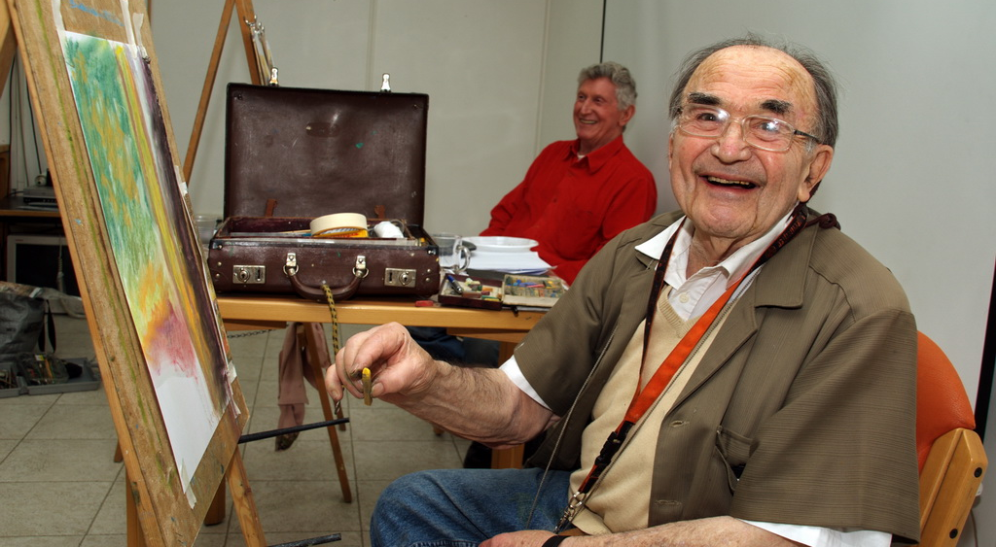
Meaningful Activities
Permission to use this image was received from Ofir Ben Natan, ESHEL, Israel
Notes:
Many were independent and led productive lives. They want to continue to have a purpose and meaning in their lives…a life worth living…well into their dementia…
…but they need our help b/c many have difficulty initiating and/or sustaining their engagement in activities…
Activities with this population need to be meaningful to the individual, enriching, appropriate, geared toward adults, culturally-specific, and failure-free…
The key is to identify for each individual the optimum point b/w overstimulation and under-stimulation…and this is a moving target as the disease progresses.
Rest periods are as important.
…
Goal: Pleasure in the moment! ||| Focus on the process, less on the outcome.
Examples of adapted activities that can work effectively with this population:
=
Music therapy; Art therapy; Physical activity; Therapeutic Gardening; visiting with Toddlers and intergenerational activities; Pets; Massage therapy and Aromatherapy; the MoMA Alzheimer’s project (visiting museums…); “Meet me at the Cinema”; maintaining connections with Nature, participation on Green Care Farms, and engagement in Spiritual and religious activities…]

Slide 14
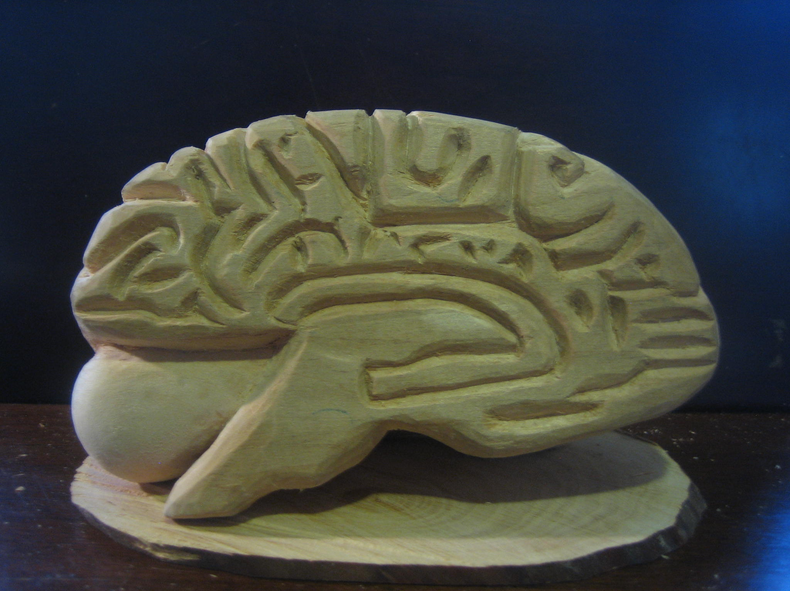
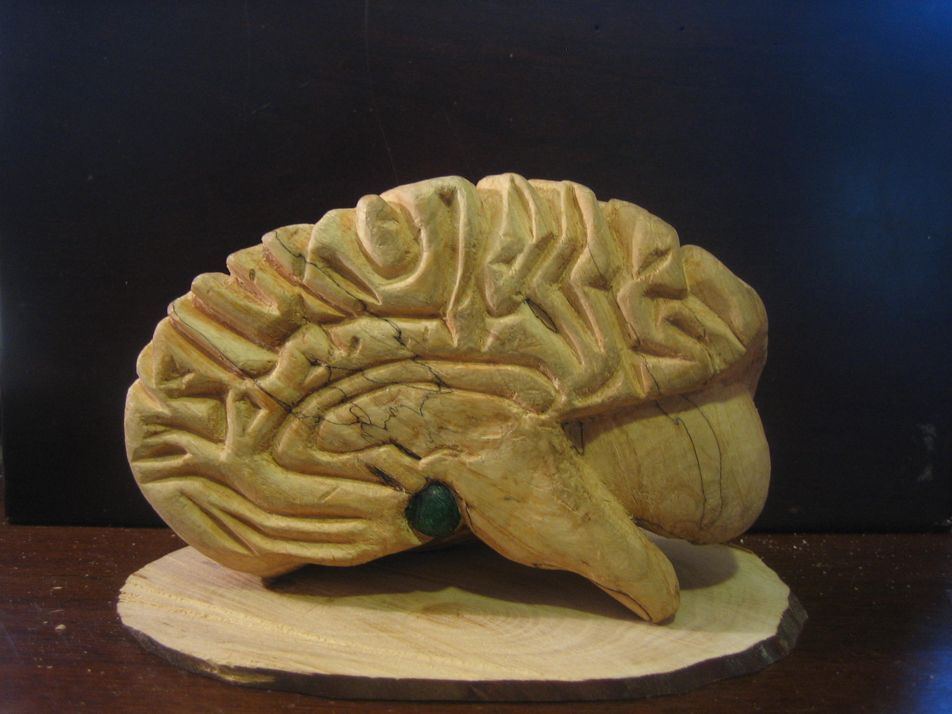
➔
An older woman with Vascular Dementia experienced severe anxiety and fear daily…
“You want to try and bridge from her deficits to her strengths. From the left part of the brain to the right part of the brain…by engaging her in meaningful activities.” – Psychiatrist
When engaged in music therapy, it was rare to see her restless or anxious…
“Its very successful in helping people under stress. I find it most useful and meaningful because it gives me a chance to relax and be clam at a time of my life when I am having great difficulty.”
Notes:
Left part of the brain – in which she has deficits such as in planning, initiating, and decision making…
Vs.
Right side of the brain – regulates emotions and does not require making complicated decisions…not cognitively demanding…
The same effect was clearly noticed with other residents who seemed lost, restless, anxious, and irritable when left alone for extended periods…
Recommend the film Alive Inside + the Music & Memory program founded by Dan Cohen…

Slide 15
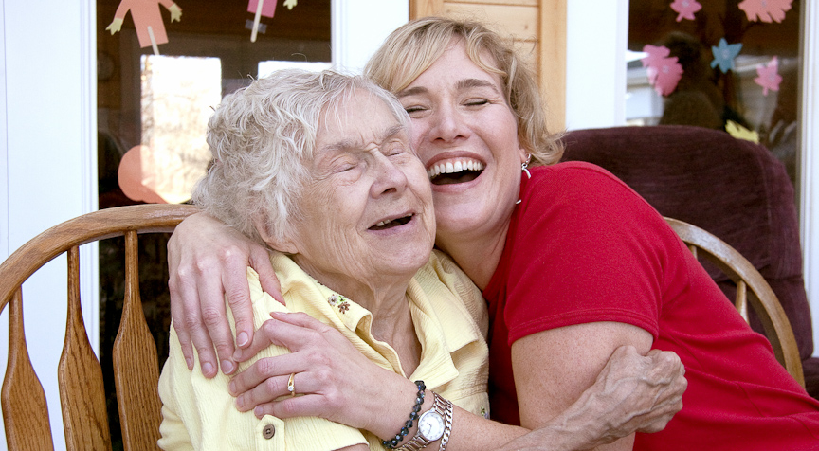
Laughter Yoga
Permission to use the image received from Dr. Cathy Greenblat,
author of the book: Love, Loss, & Laughter: Seeing Alzheimer’s Differently (2011)
Notes:
I think this picture speaks for itself…
Going to the circus – such as in innovative program by Dr. John Zeisel…Hearthstone…in Boston…
Therapeutic clowns…
Stand up comedy – Study by Stevens (2011) – showed improvement in sociability (becoming more social), communication, and self-esteem…

Slide 16
Green Care Farms
Care Farm for people living with dementia in the Netherlands:
https://vimeo.com/109903443
Dr. Simone de Bruin: https://www.youtube.com/watch?v=dVXyswGlM-4
Notes:
Video (3 minutes): Care Farm for people living with dementia in the Netherlands.
…
Do not show (6 minutes): Dr. Simone de Bruin’s video interview…

Slide 17
Deficit-based Approach
vs.
Strengths-based Approach
Abilities remain at all stages of dementia…
Notes:
“Use language that focuses on abilities (not deficits) of PwD, to help them stay positively and meaningfully engaged, and retain feelings of self-worth.” [Source: Alzheimer’s Australia’s D Language Guidelines]
+ This is not to suggest that we should ignore the cognitive disabilities. We need to identify them and compensate for them in ways that optimize the person’s function.
Preserved musical ability…
Long-term memory/Remote memory (e.g. childhood and young adulthood)
Procedural memory: Overlearned/habitual skills (e.g. swinging a golf club; playing the piano/violin)
Primary sensory functions (e.g. touch; massage; soothing aromas/essential oils such as lavender)
Primary motor functions (e.g. walking; exercising; movement; dancing)
The tendency to perseverate (i.e. doing a repetitive task e.g. folding linens and raking leaves)
Sociability and social skills (e.g. enjoying the company of others; ability to be polite)
The ability to reach out to someone in need (e.g. some of the most compassionate acts occur b/w people with dementia)
Aesthetic experience and appreciation (e.g. enjoying artwork, beautiful garden, lake, river)
Sense of humor (Resident: “The only prescription that never fails”) and the ability to smile and laugh!
The ability to be present (“In the moment”). Not 5 minutes ago but in this very second!

Slide 18
Preserved Emotional Ability
Less words is better…
It’s the emotional messages conveyed that matter the most to people living with dementia…
“They’ll respond to the unspoken…even if you said the right thing!” – Jan Garard
Notes:
Preserved emotional capacity…
Less words is better. Example:
Deaf daughter story: Denise Enderson is a daughter and care partner of her mother with AD.
||||| Denise works at Family Tree ~reproductive health clinic… works with people with HIV.|||
+
The daughter who is deaf said that she is the only one in her family that is able to communicate with her mother and gain her cooperation…
+
Her mother can hear but didn’t learn sign language…
+
|||| Denise was assisted by a sign language translator Susan Boinis|||||
[Source: Talk I gave on 6.13.13 at support group at Wilder F (Kathryn Ringham)]
=>
Less words is often better. Communication with PwD occurs mostly at the emotional level…

Slide 19
Gladys Wilson, 87 years old, in advanced Alzheimer’s disease & Naomi Feil:
https://www.youtube.com/watch?v=csSj_Ot8gE8
Validation Training Institute: https://vfvalidation.org
Notes:
Ask: How many of you have seen this video?
Naomi Feil is the founder of Validation Method:
Length of video: 5:47 minutes

Slide 20
Preserved Emotional Ability
In Alzheimer’s disease, the ability to feel the full range of emotions remains much longer than the ability to remember (short-term memory), speak, and understand…
Notes:
Show: Wood carved brain hemisphere…
…we all feel…remain fairly intact in many…much longer…

Slide 21
Person-directed Language
Accurate (“Know the facts”)
Respectful
Inclusive
Individualized
Empowering
Non stigmatizing
Culturally sensitive
Source: Alzheimer’s Australia’s Dementia Language Guidelines
Notes:
+ Culturally, ethnically, and languishingly sensitive.
Even the term dementia may not be appropriate in certain cultures…
e.g. Hmong Elders. “The Hmong do not have a word that directly translates to the meaning of dementia.” Hmong culture (White Hmong dialect) use the term “tem toob” for “memory impairment” and “chronic confusion.” |||| They have an ancient proverb that addresses this concept [translation]: “As a tree ages, it has holes. A person who ages becomes forgetful. An old tree is hollow. An old person has memory loss or impairment.”
[Source: Book: Ethnicities and the Dementias, p. 214]
+
“Some Hmong believe that tem toob (memory impairment) has a spiritual cause. Under these circumstances, a Shaman may be called to perform a traditional healing ceremony.” [p. 216]

Slide 22
Avoid Generalizations
When you see one person with dementia, you see one person with dementia…
Notes:
Every person is a unique individual with a rich and long life history… & Everyone is affected differently by brain disease…
e.g. “They are all suspicious.”
Vs.
Daughter about her mother with AD: “If she would know that she is accusative, she would have been mortified. That’s another person coming out of her. It’s really not her.”

Slide 23
Old Culture
“Elderly”
“It usually implies frailty at least, if not disability or senility” – Prof. Erdman Palmore
“Elderly” is not acceptable as a noun and is considered pejorative by some as an adjective”
– American Psychological Association (2001)
Notes:
“Some think this is a kinder term than aged or old, but it usually implies frailty at least, if not disability or senility.” – Prof. Erdman Palmore.
[Source: Palmore, E. (2000). Editorial. Ageism in gerontological language. The Gerontologist, 40(6), 645.]
+
“Elderly” is not acceptable as a noun and is considered pejorative by some as an adjective” (APA; American Psychological Association, 2001; p. 198 in Palmore’s encyclopedia).
…
[Pejorative = “Expressing contempt or disapproval.”] + Contempt (Webster) = “A feeling that someone or something is not worthy of any respect or approval.”
[[Adjective = “A word that typically serves as a modifier of a noun.”]]

Slide 24
New Culture
Older adults
Elders
Seniors
Senior citizens
Ask them how THEY prefer to be called…
Notes:
Say: These terms are considered neutral and more positive terms.
Add: Or simply say their age…
ASA Survey: What terms do you think are appropriate when referring to people ages 65+?
Older adults (80%)
Elders (41%)
Seniors (33%)
Senior citizens (11%)
Elderly (10%) [=LOWEST]
* Total is >100% b/c respondents could select more than one answer.
…
Optional: A local org Minnesota Elder Justice Center uses the term “Vulnerable Adults” as a general term that includes elders…

Slide 25
What’s in a word…
In Latin:
Dementia = “Madness”
“Dement” = “Out of one’s mind”
Notes:
Latin dēmentia madness, equivalent to dēment- “out of one's mind”
+
“Dementia” (Webster dictionary): “Insanity.” [Beyond the other definition: “Deterioration of cognitive functioning]
“Neurocognitive Disorders” (DSM 5) includes, among other conditions, different forms of dementia…
[DSM = Diagnostic and Statistical Manual of Mental Disorders, 5th edition]

Slide 26
Old Culture
“Alzheimer’s Patient”
“Demented person”
“Nursing home patient”
“Dementing Illness”
“Afflicted”
“Victim”
“Dementia sufferer”
Notes:
“Demented” (Webster dictionary): “Mad” and “Insane.”
In the old culture of care, we put the disease before the person…
Two books: “The Loss of Self” (Cohen & Eisdorfer, 2002) vs. “The Enduring Self in People with Alzheimer’s” (Sam Fazio, 2008) – reflecting two different approaches…
“A shell of his own self.”
“The long goodbye” vs. “The long hello.”

Slide 27
New Culture
A person living with dementia
People living with memory loss
An elder living with cognitive disability
Notes:
In the new culture of care, we put the person before the disease…
“Patient” – unless used in a medical setting or in the context of a medical event…
Prof. Tom Kitwood’s book: Dementia Reconsidered: The Person Comes First.

Slide 28
Caregiver
Vs.
Care Partner
Notes:
“Care Partner,” not “Caregiver”
The term “care partner(s)” is based on experts’ recommendations including Joanne Koenig-Coste, author of the book Learning to Speak Alzheimer’s,
Dr. Allen Power, author of the book Dementia Beyond Drugs: Changing the Culture of Care,
Robyn Yale, author of the book Counseling People in Early-Stage Alzheimer’s Disease.²⁰
Koenig-Coste explains, “I prefer the terms “care partner” or “habilitator” to “caregiver,” which assumes less involvement on the part of the patient.”
Robyn Yale writes that the term “care partners” was originally coined by people with early-stage dementia “who felt that it reflects less of a sense of burden and of a team approach.” Specifically, the term “care partner” reflects an approach characterized by partnership, alliance, and a collaborative and reciprocal relationship between the person with dementia and her/his care partners (as opposed to solely unidirectional relationship).
It is important to acknowledge that substantial changes do occur in the dyad’s relationship due to the cognitive changes caused by dementia (especially as the disease progresses) and these are often extremely painful for care partners particularly for family members but also for paid care partners. However, many people with dementia are able to continue to contribute in various ways to the well being of their care partners, family members, friends, community, and society well into their disease. This, if the care partner is aware of this potential and is able to create the conditions and opportunities for them make these contributions.
…
Add: …though in the later stages of dementia, some family members prefer the term caregiver…as they caring tasks become heavier…

Slide 29
Old Culture
“Burden of Care”
Yes, it can be extremely distressing and difficult…
“You cannot understand caregiving unless you do it.”
– Prof. Arthur Kleinman, caring for his wife with Alzheimer’s disease:
https://www.youtube.com/watch?v=UxosTKujwWQ
Notes:
“Burden of Care.” – This term is used frequently in the practice and research related to family care partners of people living with dementia…
It is usually used to describe the family care partner’s perception of the care s/he provides and impact that care has on her/him…
“Burden” assumes that the role is entirely negative” [Alz Australia…] – when the experience by family members varies from one person to another…
+
One of the most common instruments for evaluating the perceived impact of caring for a PwD is called “Burden Interview” developed by Prof. Zarit.
Zarit Burden Interview (Short 12-item version; 2001):
Items retained from the Zarit Burden Interview for the short and screening versions.
All questions are answered as “never” (0), “rarely” (1), “sometimes” (2), “quite frequently” (3), or “nearly always” (4).
DO YOU FEEL . . .
that because of the time you spend with your relative that you don’t have enough time for yourself?
stressed between caring for your relative and trying to meet other responsibilities (work/family)?
- angry when you are around your relative?
- that your relative currently affects your relationship with family members or friends in a negative way?
- strained when you are around your relative?
- that your health has suffered because of your involvement with your relative?
- that you don’t have as much privacy as you would like because of your relative?
that your social life has suffered because you are caring for your relative?
- that you have lost control of your life since your relative’s illness?
uncertain about what to do about your relative?
you should be doing more for your relative?
you could do a better job in caring for your relative?
Arthur Kleinman’s video interview (18 minutes): https://www.youtube.com/watch?v=UxosTKujwWQ

Slide 30
Positive Aspects of Care
Deep personal meaning
Fulfilling / Rewarding
Purpose in life
Personal growth
Opportunity to give back to a loved one
Development of resiliency
Learning about aging & what it means to grow old
Improvement in relationship with a relative
Learning to be fully present
Finding joy with the person in the moment
Spiritual growth / Increased faith
Notes:
We know that some family members caring for these individuals report not only negative aspects and impacts of caring for their loved ones. They also describe positive aspects of caring for these individuals, including personal growth, deep meaning, purpose in life, opportunity to give back to a beloved and caring parent or spouse, some report that they developed resiliency, others report that they learned a lot about aging and what it means to grow old, learning to appreciate being present and supportive of another person, and even finding joy and humor in the moment with the person.
Family care partners also report positive aspects of caring for their loved ones:
Sanders reported that between 55% and 90% of caregivers experienced positive experiences such as enjoying togetherness, sharing activities, feeling a reciprocal bond, spiritual and personal growth, increased faith, and feelings of accomplishments and mastery.
[Source: Sanders S. Is the glass half empty or half full? Reflections on strain and gain in caregivers of individuals with Alzheimer's disease. Soc Work Health Care. 2005;40:57–73.]
[]
[Source: Cohen CA., Colantonio A., Vernich L. Positive aspects of caregiving: rounding out the caregiving experience. Int J Geriatr Psychiatry. 2002;12:184–188.]
…
Prof. Kleinman who cares for his wife with AD:
Talks about the influence of the Chinese Tradition and the Confucius Tradition…on ethical issues and moral issues…
That tradition has some remarkable ideas about the sort of issues that I am relating to now: “Respect for someone else” “Your own humanness deepens as you engage in the humanness of somebody else…and there is nothing like vulnerability and difficulty to bring out that humanness…so the humanness is in that relationship…”
It made my life richer, deeper feelings,…real person.
Being present in the act itself…fully present.
Presence…you are present with the other person.
Professional caregivers are sometimes present and sometimes not.

Slide 31
Old Culture
“Institution”
“Facility”
“Skilled Nursing Facility”
“Ward”
“Care Unit”
“Memory Care” / “Memory Care Unit”
“Special Care Unit”
“Dementia Unit”
“High Functioning Unit” vs. “Low Functioning Unit”
2A; 5B, etc.
Notes:
“Memory Care Unit.” Are we caring for memory? Or are we caring for whole human beings with a holistic approach?
+
As Dr. John Brose says in the context of behavioral expressions, it is rare that he and his team are called to a nursing home b/c of someone’s memory impairments. It is usually as much other cognitive disabilities intersecting with lack of adequate and skilled care and unmet human needs and frustrations that lead to behavioral expressions…
“SCU.” Often used for marketing purposes. Large spectrum and variation in care resources, components, and capabilities.
+
Article called: What’s so special about SCUs?
=
The terms “Memory Care,” “SCUs” and “facility” are frequently used by many LTC homes for people with dementia in Minnesota as published in the 2016 SeniorCare Guidebook of Care Options Network (in the “Memory Care” section).

Slide 32
New Culture
Care Home
Long-Term Care Home
Household
Neighborhood
Green House
Notes:
This is for all practical reasons their home. Even if the majority never chose to live there…

Slide 33
Old Culture
“Confused”
“He is very, very, very, very confused.”
“She is ultra ultra confused.”
“The only thing that they have in common is that they are all confused.”
Notes:
Yes, they have dementia and they may seem confused to us…. But the real question is: How is this going to help us better understand their needs and meet them?
“Confusion is an overused, often misused, and even potentially dangerous term. It is far too often used to label behavior that the caregiver does not understand. Having labeled the behavior, the caregiver is inclined to stop trying to understand its cause. The danger is that the behavior is simply accepted as a manifestation of dementia” (Zgola, 1999, pp. 8-9).
+
Dr. Allen Power draws the distinction between two fundamentally different approaches: “He is confused because he has dementia.” Vs. “I am confused because I don’t know what he is trying to tell me.” Which of these approaches reflects a person-centered approach?
Zgola story:
“I once intercepted a very old gentleman at the nursing home door who told me that he was in a rush to go see his mother. Fortunately, my efforts to ensure the safety of this apparently ‘confused’ gentleman did not cause him to miss the cab that was waiting to take him to his mother’s 107th birthday party. Who was the confused one here?”
||| [= Zgola explains: “Another danger potentially associated with the word ‘confused’ occurs when it is used to describe one person’s rational behavior while not fully aware of the circumstances.”]
[Source: Zgola’s book (page 9): Care that Works: A relationship Approach to Persons with Dementia]

Slide 34
New Culture
“He is confused because he has dementia.”
Vs.
“I am confused because I don’t know what he is trying to tell me.”
Which of these approaches reflects a person-centered approach? – Dr. Allen Power
Simply describe the specific difficulty or impairment
(e.g. planning, initiating, sequencing; dressing; eating;
reaching desired destinations (locating bathroom);
completing a sentence; finding the right word, etc.)
Notes:
e.g. Difficulty getting from point A to point B…from the living room to the bathroom… from the activity room to the dining room… to locate his seat in the dining room…
+ To complete his sentence; to find the right word; to initiate engagement in an activity…

Slide 35
Behavioral Expressions
Notes:
Behavioral expressions of unmet human needs and frustrations… Something frustrating, upsetting, or threatening (perceived or real) in the social and physical environment…
Why focus on behavioral expressions? Certain behaviors are very distressing to the person and her/his care partners and can result in harm and safety risks…

Slide 36
Old Culture
“Problematic Behaviors”
“Disruptive Behaviors”
“Behavior Symptoms”
“Neuropsychiatric Symptoms”
“BPSD”…or more accurately “BPSOD” (Dr. Al Power)
“Abnormal Behaviors”
“Dysfunctional Behaviors.”
“Catastrophic Behaviors.”
Notes:
“Disruptive behaviors” is a term that reflect the care partner’s view more that the PwD…. While behaviors (repetitive questions) can interfere and disrupt care, they may be expressions of unmet needs (Algase et al. 1996)
BPSD = Behavioral and psychological symptoms of dementia VS. BPSOD = “…Over-medicalized…” -- Dr. Allen Power
Excess Disability = Attributing behavioral expressions predominantly to the disease also runs the risk that the resident will experience excess disability, which is disability caused by factors other than the disease or impairment itself (i.e., usually unmet needs and factors in the physical and social environment). As explained by Professor Steven Sabat, “From strict medical/technical approach, behavior problems have been viewed generally as caused by brain pathology alone and, as a result have been deemed to be symptoms of the disease, rather than reactions to the social milieu in which the afflicted person lives.”
[Source: Sabat SR. Excess disability and malignant social psychology: A case study of Alzheimer’s disease. Journal of Community and Applied Social Psychology. 1994;4(3):157-166.]

Slide 37
“Difficult Behaviors”
“Challenging Behaviors”
Vs.
“Behaviors that challenge” (Better wording…)
– Prof Moniz-Cook & Clarke (2013)
Notes:
The term “Behaviors that challenge” is better b/c it implies that it is others, not necessarily the person with dementia themselves, who are being challenged.” [Source: Moniz-Cook & Clarke (2013)] i.e. not automatically communicating that these expressions are inevitably challenging…
This is by no means to suggest that behavioral expressions in PwD can not be “difficult” for family care partners and professionals…

Slide 38
Quote
“I don’t like the words difficult behaviors or even challenging behaviors. If you imply that it’s difficult or challenging, you are already putting a stigma on the person...and you don’t want to work with them. It’s like someone is saying: ‘They are having a very challenging behavior’ ...immediately, what do you feel? You feel that a brick wall comes up. Okay, I am ready for their challenging behavior. Everyone has behaviors...good and bad...whether we are with it or not with it...so why already classify them as difficult or challenging? You are not giving them a chance.” – Director of Recreation Therapies

Slide 39
Old Culture
“Agitation” / “Agitated”
Notes:
“Agitation” & “Agitated.” One of the most commonly used terms in the research and literature with regards to behavioral expressions in PwD...
I used this term “agitative behaviors” in my doctoral dissertation 6 years ago… I no longer do.. The term is too vague i.e. It doesn’t tell us what the actual behavior is…and therefore it is often not helpful!
||||| [The term consist of dozens of behavioral expressions categorized into 4 domains, including:
1. Verbally non-aggressive; 2. Verbally aggressive; 3. Physically non aggressive; 4. Physically aggressive.|||||
Interestingly, Webster dictionary definition of “Agitate” is: “To discuss earnestly” + “To attempt to arouse public feeling.” I like that… They are telling us something important, when words fail, that’s how they tell us that their needs are not met, that something frustrates them, upsets them, makes them angry, or that they feel threatened in some way…
[Earnest (webster definition) = “An intensely serious state of mind.”]
+
Sloane et al. (1998) study:
= A substantial variability in the manifestation of “agitated” behaviors was found to exist across 53 long-term care residences for people with dementia (i.e., 0%-38%). [SCUs]
What accounted for the difference? The researchers found that the quality of the physical environment & the amount and quality of staff-resident interactions (including staff attitudes toward residents) were exerted strong influences on agitation levels. Found “evidence suggesting that both the physical environment and the actions of staff have significant impact on agitation levels.” Sloane et al. (1998): The proportion of residents exhibiting agitated behavior varied from 0% in some units to 38% in one unit.
[Source: Sloane et al. (1998). Environmental correlates of resident agitation in Alzheimer’s special care units. JAGS, 46, 862-869.]

Slide 40
Old Culture
“Disruptive vocalizations”
Notes:
Vs.
Expressive therapist: “She has a different way of communicating.” Or simply describe what you see and hear…
Various forms of vocalizations expressed by certain residents with dementia often frustrate and annoy other residents and care partners and frequently trigger episodes of DHRRI. These include, among others, repetitive loud speech or questions, requests for attention or help, calling out, making noise, screaming, yelling, and moaning.
For example, repetitive questions. A resident may ask: “Where is the door? Where is your car?” Staff: “She is so obsessive.” “She is like a broken record.”
[Opinion Box]
The word “Disruptive” vocalizations in the context of people living with dementia (a frequent term used in the practice and research literature) should be avoided. Most, if not all, of these vocalizations have a cause, meaning, and purpose to the resident with dementia (even if she or he may not be able to verbally articulate what these are). While many of these behavioral expressions are often perceived as annoying by other residents and direct care partners, labeling these verbal expressions as “disruptive” reduces the likelihood that direct care partners will seek to identity and address the frustrations and unmet needs that often underlie them.
+ As explained by Professors Jiska Cohen-Mansfield & Lori Schindel Martin (1999). “Sometimes the main purpose of treatment is change in subjective perception of disruptiveness of behavior rather than change in the behavior itself.”
Example
One resident engaged in extremely frequent number of questions and statements during a very short period of time…often dozens of times within 10 or 20 minutes… BUT, when this same individual was holding a kitten on her lap during pet therapy group activity, there was a dramatic reduction of these verbal expressions.

Slide 41
Barrier in Research…
De-contextualization of behavioral expressions…
“Methods that divide the behavior continuum into arbitrary time intervals dismantle the behavior stream. The destructive effect of these methods is automatic when they involve bits of behavior stream that are shorter than the units of the behavior phenomenon with which one is concerned.”
– Barker (1963) In his book The Stream of Behavior
Notes:
Barrier in research and practice. In research = “Time Sampling” observational schedules.
= Rigor vs. Relevance.
De-contextualization of behavioral expressions in practice and research.
= Out of context. When behavioral expressions can only be understood in the context in which they occur.
YARD STICK EXERCISE. Ask for a volunteer…
Most research instruments designed to capture various forms of behavioral expressions do not capture the context, circumstances, and sequence of events leading to the behaviors. See: Rigor vs. Relevance. Instructions to log the behavior in what is called “time sampling” observational schedules.
A study examining the relationship between behavioral expressions and friendships among 59 residents with mild-to-moderate cognitive impairment in a “SCU”of an intermediate care home (Kutner et al., 2000). Three scans per hour were conducted (each lasting 3 to 5 minutes), seven days a week, between 9:00 a.m. and 9:00 p.m., for six months, producing more than 17,000 units of observation. Observations were instructed to begin the first scan at the top of the hour, the second scan at 25 minutes after the hour, and the third scan at 50 minutes after the hour. The pre-determined order of the observation was the day room, hall/nurses’ station, and dining room, unless there was a scheduled meal, in which case the order was reversed.
Another study examined the differences in resident affect, alertness, and behavior during “recreation time” (i.e., time residents were engaged in organized recreational therapy) compared to “ordinary time” (i.e., all other time from 9:30am to 6:30pm when not engaged in recreation). Each researcher observed eight nursing home residents (out of 35 residents), in a random order, for five minutes each hour (Schreiner, Yamamoto, & Shiotani, 2005). The results showed that there were no observations of “angry” facial expressions in the entire 3,854 minutes (i.e., more than 64 hours) in which the 35 residents were observed. The researcher stated, “A striking finding was the virtual absence of agitated, aggressive, or ‘problem behaviors’ in our sample.
In his book The Stream of Behavior Barker (1963:19) explains,
“Methods that divide the behavior continuum into arbitrary time intervals dismantle the behavior stream. The destructive effect of these methods is automatic when they involve bits of behavior stream that are shorter than the units of the behavior phenomenon with which one is concerned.”
+ Ryden Aggression Scale (RAS) vs. CareMedia. The RAS captured only 56% of episodes of physical “aggression” b/w residents that were captured when using video recordings in the public spaces of a care home for people with dementia. [= Check Baharuch grant application…]

Slide 42
New Culture
Behavioral Expressions (Dementia Initiative)
Expressive Behaviors (Dr. Allen Power)
Reactive Behaviors (Dr. Paul Raia)
Responsive Behaviors (Lisa Loiselle, M.A.)
“Expressions of unmet needs” (Alzheimer’s Australia)
Caspi, E. (2013). Time for change: Persons with dementia and “behavioral expressions,” not “behavior symptoms.” Journal of the American Medical Directors Association, 14(10), 768-769.

Slide 43
Responsive Behaviors
Definition
“A response to something negative, frustrating, or confusing in the person’s environment.
It places the reasons or triggers for challenging behaviors outside, rather than within, the individual,
thereby recognizing that problems in the social and physical environment can be addressed and changed”
Loiselle (2004) - Murray Alzheimer’s Research & Education Program
Notes:
Add: Of course, …intersecting with the person’s cognitive disabilities…
|||| [Lisa Loiselle, L. (2004). Identifying responsive behaviors in long term care. Innovations, 3, 1. Murray Alzheimer’s Research and Education Program]

Slide 44
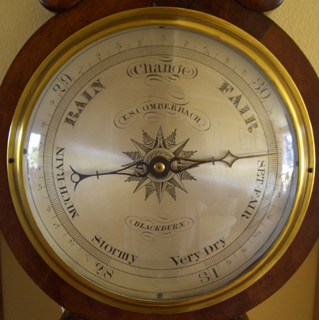
Behavioral Expressions
Usually expressions of unmet needs and frustrations
They often have purpose, function, & meaning to the person
Attempts at communication to be explored with validation
Attempts at gaining control over unwanted/threatening situations
Attempts at preserving dignity, identity, and personhood
=> Barometers for tolerance to stressful stimuli…
Notes:
We know from a lot of research and practice that behaviors in this population are usually…
“Behaviors are communications that need to be explored with validation…” Judy Berry ((Revolution in Alzheimer’s, Dementia, and Memory care; You Tube)
||| [A means of fulfilling needs (Cohen-Mansfield, J. & Taylor, L. 1998). Assessing and understanding agitated behaviors in older adults. In M. Kaplan & Hoffman, S.B. (Eds.), Behaviors in dementia: Best practices for successful management. Baltimore: Health Professions Press.]
Barometers…and therefore can be useful in informing and guiding development of individualized interventions…
[UNTIL HERE]
[Definition of Barometer: an instrument that is used to measure air pressure and predict changes in the weather; + something that is used to indicate or predict something]
Emotional rollercoaster = during my 10-month direct observation study I say time and again how many with dementia experience difficult emotional rollercoaster largely determined by events in their environment

Slide 45
Reflection Question
How about not using the term “behavior” at all?
“I have moved to dropping the word ‘behavior’ completely” – Dr. Allen Power
Notes:
Leading educators such as Dr. Allen Power and some of the best LTC homes out there (such as English Rose Suites = Vicki Martini) insist on not even using the term “behaviors” anymore…They truly see these acts as human expressions and communications of unmet needs.
Ask: When was the last time you heard the word “behaviors” used in a positive connotation in the context of PwD?
Dr. Al Power, author of two fabulous books related to people living with dementia: “I have moved to dropping the word “behavior” completely.”
“I like the term ‘personal expressions,’ but often just say “people’s words or actions,” or simply describe what I see or hear in a neutral way.”
“Expressions of unmet needs.” [source: Alz Australia Guidelines]

Slide 46
Old Culture
“Inappropriate behavior.”
Notes:
Naomi Feil, founder of Validation Method: “To understand a person’s behavior, his or her physical strengths, social needs, and psychological needs must be known. Behavior cannot be judged appropriate or inappropriate unless it is viewed within the context of these needs .” + “All behavior must be viewed within the context of what is appropriate at each stage of life.” [Source: p. 29 in VT book 2002]
Example I
A resident with AD in my study. During a group activity, an older woman with AD walked into the middle of the room and started taking her pants off… It is tempting to call this an “inappropriate” behavior. However, it turns out that this woman felt uncomfortable in her adult depends and needed to assistance in straightening it. She was helped to go to her bedroom when she received assistance in making her feel comfortable. She returned to the group activity and no longer engaged in this “behavior.”
Example II
Rectal discomfort from constipation (Scatolia). Digging in his rectum and smearing feces… Cause: he had constipation. Once treated, he no longer touched it.
=
||| [A 79-year old male with mixed dementia (cerebrovascular accident and subdural hematoma) was admitted to a Community Living Center (formerly called VA nursing home) after hospitalization for an acute onset chronic subdural frontal hematoma after a fall. “On admission, he often yelled ‘Help me, help me.’ When asked what his needs were he could not explain his distress and would say things like ‘I need to get out of here.’ The resident frequently dug in his rectum and placed the feces in a bedside paper cup or smeared it around. At times he would throw his feces on the floor or against the window. Once it was pointed out to him that his fingers were dirty with stool, he started licking them.” Failed intervention: Interventions consisting redirection and use of mittens have failed (the mittens increased his “agitation”). Successful intervention: “The resident was started on a bowel regimen, and an order was placed to do a rectal exam every morning, and give enema if stool was present. Nurses were supported and encouraged to focus on the toileting plan. Outcome: With an aggressive bowel regimen focused on preventing constipation, smearing of feces (i.e., scatolia) resolved, yelling decreased, and all antipsychotics discontinued.” The unmet need causing the behavioral expression was rectal discomfort from constipation. The authors reported, “Llaxatives, rather than antipsychotics completely resolved the distressing behavior.” + These authors reported on 14 other elders with dementia who smeared feces – all were found to have constipation, which was resolved with laxatives.]
[Source: Holmes KJ, Gentili A. The message behind the behavior: Successful management of Scatolia in a resident with dementia. Journal of the American Medical Directors Association. 2013;47:235-242.]
+
Oftentimes, when you look closely, it is the “inappropriate” things that well meaning but overworked and unskilled care partners do that trigger these behavioral expressions…

Slide 47
New Culture
“To understand a person’s behavior, his or her physical strengths, social needs, and psychological needs must be known. Behavior cannot be judged appropriate or inappropriate unless it is viewed within the context of these needs .”
– Naomi Feil, founder of Validation Method
Notes:
Say at the end: …and oftentimes it is the inappropriate behavior of staff and other professionals that contributes to or directly causes or triggers the behavioral expression…
…
[Quote by Naomi Feil is from page 29 in VT book 2002] + [I didn’t include in the slide: “All behavior must be viewed within the context of what is appropriate at each stage of life.”]

Slide 48
“A substantial proportion of behaviors in dementia arise when care does not appropriately address the underlying causes”
– Prof. Cohen-Mansfield & Mintzer (2005)

Slide 49
Old Culture
“Sundowning”
“The term sundowning should be replaced”
– Prof. Cohen-Mansfield
Notes:
Sundowning.
=
The term “sundowning” refers to increase in restlessness, anxiety, and different distressing behavioral expressions in people with dementia in the late afternoon and evening hours. However, a study has shown that only one-quarter of 174 residents in 12 nursing homes experienced an increase in “agitation” in the late hours
+
Prof. Cohen-Mansfield’s study found that only one-quarter of 174 residents in 12 NHs experienced an increase in [behaviors] agitation (ABMI) in the late hours.
Cohen-Mandsfield concluded her study: “The term Sundowning should be replaced”
[= Cohen-Mansfield (2007). Temporal patterns of agitation in dementia. American Journal of Geriatric Psychiatry, 15(5), 395-405.]
+
Example: Every evening after dinner a resident with dementia shouts “I need a line x3”…

Slide 50
Example
(Catherine Unsino)
Every day at 6:00pm a resident becomes “aggressive” and screams: “I need a line, I need a line, I need a line.”
Staff couldn’t understand what he meant…
Life history: A traveling businessman who used to call his wife every night to tell her “Good night” and “I love you.”
Intervention: Staff let him call his wife before 6:00pm
Outcome: The behavior was eliminated, he was calm, and psychotropic medications were avoided…
Notes:
…becomes aggressive…e.g. slamming drawers & throwing books across room
Ask: Would it be appropriate to call this resident “a Sundowner” ?!
We have to recognize that for a person with dementia it takes a 100 times more effort and energy just to go through the morning, let alone have enough energy in the late afternoon and evening hours… Things and tasks we take for granted can be draining and exhausting for this population.

Slide 51
Reflection Question
“If you had the perfect pill that could take away these behaviors…without side effects…would you give it to these people…even when you know that the pill will not address the unmet needs that cause the behavior?”
– Professor Cohen-Mansfield, as cited by Dr. Allen Power
Notes:
AFTER ASKING THE QUESTION…PAUSE FOR 10 SECONDS …and then move on to the next slide without saying anything…
A national study in Canada evaluated reduction of inappropriate antipsychotic medications in 416 seniors in 56 LTC homes. Found fewer falls (20%), less aggressive behaviors and resistance to care and improved QoL for residents. [“Verbally abusive behavior” decreased by 33%” ; “Physically abusive behavior” decreased by 28%] [“Family members say they now have their loved ones back.”]
[Source: Canadian Foundation for Healthcare Improvement; Article by Nadine Morris, May 16, 2016; New National Results: Taking Seniors off antipsychotics shows dramatic improvement in care.

Slide 52
New Culture
Tired
Over-stimulated
Bored
Inadequate lighting
Unmet human needs and frustrations
“Dementia does not cause sundowning – we do”
– Dr. Allen Power
Notes:
Share: Prof. Cohen-Mansfield’s study found that only one-quarter of 174 residents in 12 NHs experienced an increase in [behaviors] agitation (ABMI) in the late hours. Cohen-Mansfield concluded her study: “The term Sundowning should be replaced”
[Source: Cohen-Mansfield (2007). Temporal patterns of agitation in dementia. American Journal of Geriatric Psychiatry, 15(5), 395-405.]

Slide 53
Old Culture
“Wandering”
The “wanderer”
“He is an intrusive wanderer”
“Aimless wandering”
Manager: “Don’t say ‘that’s a wanderer.’ That puts a label on them.”
Instead, try to identify the function of the behavior, the underlying unmet need that drives it. Is the person looking for something familiar and/or meaningful to do?
Notes:
“Wandering” – hate this word – is a serious public health problem… According to one estimation, every week at least one elder leaves a care home unattended and dies for various reasons… The Alzheimer’s Association reports that substantial number of people with AD will at some point in the disease will “wonder”
“Wander” [webster definition]: “To move about aimlessly or without a fixed course of goal.”
Vs.
Vittoria’s study in a care home for PwD: Wandering vs. “Getting Busy,” “Moving,” and ”Walking”
Mishler and his colleagues (1981) argue that, when one is labeled as a patient and begins to behave like one, certain symptoms that may have been transient become “locked in” as appropriate or associated with the role of the patient. Thus, the label has been accomplished. A classic example of this in the medical literature is the “wandering” phenomenon of “unpredictable pacing without a goal” associated with Alzheimer’s as an accompanying indicator and outcome of the disease.
Members of the staff suggest that there are alternative meanings to continual “movement” by residents with AD (defined as “wandering” in the medical model, which connotes aimless, meaningless movement). Only once did a staff member use the word wandering in my many hours of interviews with them.
Furthermore, I never heard it used during the course of my months of observation on the Unit.
Rather, CNAs spoke of residents “stirring,” “moving,” “movin’ on,” “keepin’ busy,” “getting busy,” “walking,” “pacing,” or “staying busy”-- words connoting or connected with some purpose. This alternative language reflects what I call “rhythms of the social world” of the residents, where movements are far from meaningless or aimless.
Lyman (1989, p. 600) observes that “the relativity of this definition becomes clear if it is applied to a young man pacing the halls of a maternity ward.” Her comment helps to keep this tendency in perspective.

Slide 54
New Culture
Seeking to do something personally meaningful
Trying to…
Alleviate boredom
Get to a familiar or safe place
Be in close relationships with others
Gain a sense of control
Feel physically comfortable (e.g. alleviate pain)
Notes:
[Option only: Or simply say: “Became lost when trying to x, y, z…”]

Slide 55
Old Culture
“Eloping”
“Exit seeker”
Notes:
“Eloping” (Webster dictionary) = “To run away.”
“Exit seeker”
Would YOU want to live in a typical nursing home in America? How many of us would try to leave it in any way we can? I would...
Staffing: Half NHs in this country are understaffed and one-quarter are dangerously understaffed (Review by Harrington et al. 2016). Training: Many direct care partners do not receive adequate training in working with and caring for elders with dementia and recognizing and preventing their behavioral expressions.
+
Lack of activities. Most residents in nursing homes are not engaged in something meaningful most of their days.
=> Bored, feeling useless, lacking meaning and purpose in their lives, they express their frustrations through behavioral expressions, including trying to leave the home.

Slide 56
New Culture
Example I
“If only I could, if only I could…find a buyer for my cow.” – Shimon the pioneer
(Source: Golander & Raz, 1996)
Example II
The farmer who wanted to “check on the cows”
(Source: Dr. Allen Power’s book Dementia Beyond Disease)
Notes:
Example I: Early-life occupation and current “wandering”
Shimon, an 84-years old resident with dementia used to disappear from the care home. When accused by the staff of running away, he replied:
“How can you accuse me when I am trying so hard to do my best?”
One one October cool night Shimon disappeared from the care home. Only after several hours he was found safe and sound but wet and trembling. In the morning following his escape, few residents approached Shimon, who was sitting in a chair murmuring: “If only I could, if only I could…” When asked by another resident: “If only you could what?” He replied immediately and confidently: “Find a buyer for my cow!” Shimon’s past biography was reassessed to explain his behavior: In his early life he used to work in the cowshed. His disappearances were explained by his deep urge to complete certain unfinished tasks and as a natural part of a pioneer’s yearning for the “free land.”
[Source: Golander & Raz, 1996]
+
Example II:
“During a speaking trip to Iowa in 2011, I heard the story of a gentleman who lived in an assisted living home in a rural part of the state. He was repeatedly attempting to exit the back door, and each time was redirected by his care partners, who did not feel he was safe walking outside alone. His attempts to go outside became more insistent with each redirection. Finally, the administrator suggested that the staff not interfere the next time he opened the door, but simply watch from the doorway, to see what he might be trying to accomplish. When they did so, the gentleman walked to the fence at the back of the yard, which adjoined a cow pasture. He watched the cattle grazing for about 10 minutes, and then turned around and came back inside. In soliciting more information about the gentleman, they learned from his family that he had been a farmer who would go out every day to ‘check on the cows.’ This pattern was being repeated at the home, and once this longstanding practice was revealed, he was able to do so daily, with the knowledge that his identity was being preserved and his needs fulfilled”
[Source: Dr Allen Power in his book: Dementia Beyond Disease: Enhancing Well-Being (2014). Health Professions press.]

Slide 57
Old Culture
“Unprovoked”
Notes:
…
“Unprovoked” – Most elders with dementia do not engage in…for instance…behavioral expressions labeled as “aggressive” without a cause or trigger…

Slide 58
New Culture
“Avoid labeling behavioral expressions as “unpredictable” or “unprovoked.” Instead, try to identify and address triggers and reinforcers”
– Dr. Stephen Weber Long

Slide 59
“Labeling the behavior ‘aggressive’ assumes that this behavior is intentionally initiated by an individual with dementia.
In most cases, however, individuals with dementia do not initiate aggressive behavior without provocation.”
– Prof. Volicer & Hurley
Notes:
Volicer & Hurley (2003, p. 838) in the context of personal care… Authors of the book with Mahoney (1st author): Management of Challenging Behaviors in Dementia (2000)

Slide 60
Old Culture
“Abusive”
“Violent”
“Aggressive”
Notes:
Volicer & Mahoney (2002): “We believe that there is strong evidence that ‘aggressive’ should not be used to describe behavior of residents with dementia during care.”
[Source: Letter to the Editor: “Are nursing home residents with dementia aggressive? The Gerontologist, 42(6), 875-876]
Akerstrom, M. (2002). Slaps, punches, pinches but not violence: Boundary work in nursing homes for elderly. Symbolic Interaction, 25, 515-536.
Abstract: This article presents an analysis of boundary work in the context of care for the elderly, where violence appears to be widespread but is still relatively unacknowledged. Talk about aggressive patients was formulated in a particular way among workers in a nursing home. Nursing home staff described how the elderly residents sometimes slapped, pinched, or hit them. Although staff members could describe these acts as intentional, although they could hold patients responsible, and although this violence could end in injuries, demarcations were made such that aggressive acts were constructed as somehow not really “violence.” As “violent” is an inherently exclusionary label, this downplaying can be seen as an effort to avoid pushing persons outside the boundary of normalcy and of continued acceptance. Placing the elderly's violence outside the boundaries of violence means that the elderly remain “care takers,” the staff “caregivers,” and the nursing home a “caring context.”
Link to abstract: http://onlinelibrary.wiley.com/doi/10.1525/si.2002.25.4.515/abstract

Slide 61
Avoid…
“Blame the person with dementia approach”
Be aware of…
Self-fulfilling prophecy
Notes:
“Blame the victim approach,” masking the underlying meaning and purpose of these behaviors. Thus, creating a self-fulfilling prophecy
Full moon study (Cohen-Mansfield et al. 1989)
Abstract
This study examined the effect of the full moon on agitation manifested by nursing home residents (N = 24). Observations of agitation were recorded on a behavioral mapping instrument, and occurrence of the full moon was operationalized in the three ways most commonly cited in the literature. The hypothesis that elderly nursing home residents become increasingly agitated during a full moon was not supported by this study. ||||| In all analyses, agitation was observed less often when the full moon was full than during the other three lunar phases, although differences were not statistically significant.]
Link to abstract: http://www.ncbi.nlm.nih.gov/pubmed/2768501
[Source: Cohen-Mansfield et al. (1989). Full moon: does it influence agitated nursing home residents?]

Slide 62
Old Culture
“Your father is difficult.”
These are the two “trouble makers” here
The “stalker” (“He is like Velcro”)
The “pincher”
The “Attention seeker”
Notes:
I once heard a CNA saying this to a loving and dedicated daughter of an person with dementia during a care planning meeting: “Your father is difficult.”
+
On another occasion, I heard a CNA telling her co-workers about a new resident: “She is difficult.”
=> A manager in response: “You just sent the wrong message because everyone works differently.”
“The pincher is in my mother’s bed.”
vs.
A manger said: “It’s really slaps a label on her.”

Slide 63
Old Culture
“Non-pharmacological” interventions
“Non-pharmacologic infers a medical focus rather than holistic one” – Karen Love, Dementia Action Alliance
The first line of treatment for “agitation” and aggression (that do not present immediate danger to the resident or others) in people with dementia consists psychosocial (formerly called “non-pharmacological”) approaches/interventions
Notes:
“Non-pharmacological” interventions. It is ironic that many professionals and researchers are still using biomedical terms to describe psychosocial approaches.
It is a testament to the tremendous power and influence of the biomedical model of care on our ways of thinking…
+
Karel Love, co-founder of DAA says: “Non-pharmacologic” infers a medical focus rather than holistic one.”
Experts’ consensus in the U.S. and Europe state that the first line of treatment for “agitation” and aggression (that do not present immediate danger to the resident or others) in people with dementia consists psychosocial (formerly called “non-pharmacological”) interventions.
[Sources: Howard R, Ballard C, O’Brien J, Burns A. Guidelines for the management of agitation in dementia. International Journal of Geriatric Psychiatry. 2001;16(7):714-717.
+
Consensus statement on improving the quality of mental health care in U.S. nursing homes: Management of depression and behavioral symptoms associated with dementia. Journal of the American Geriatrics Society. 2003;51(9):1287-1298. ]

Slide 64
New Culture
“Personalized practice or approach”
(Dementia Initiative – Experts’ consensus)
“Individualized practice”
(Dementia Action Alliance. White Paper: Words Matter)
“Psychosocial approach”
Notes:
Psychosocial approach = An approach to care that places strong emphasis on meeting the person’s psychological and social needs… So often neglected in care for this population!

Slide 65
During Personal Care
Notes:
Interactions between staff and residents during assistance with bathing, using the toilet, and dressing…

Slide 66
Old Culture
“Resistance to care”
“Resistive”
“Combative”
“Aggressive”
Notes:
“Resistance” = One definition in Webster dictionary which I found interesting is:
“The inherent ability of an organism to resist harmful influences (as disease or infection).

Slide 67
“When a resident refuses something, he has a good will…a good reason to refuse.” – CNA
Notes:
– CNA with over 25 years of experience caring for this population
Add:
Think of it…if a stranger would come into your room and would say, ‘Come with me to take a shower’…it can be terrifying.

Slide 68
Video Study I – “Elderspeak”
(Williams et al. 2009)
20 residents; 3 care homes for people w dementia;
80 staff-resident interactions during personal care
Focus: “Resistance to care”
Analyzed interactions frame-by-frame
Results
“Resistance” to care was greater following Elderspeak communication style…
Notes:
Elderspeak communication style includes: patronizing, baby talk, infantilizing, controlling, dominating, and bossy speech...
This means that many of the behaviors that we often call aggressive are actually attempts by the residents to defend themselves in threatening situation…

Slide 69
Video Study II
(Somboontanot et al. 2004)
18 residents with dementia; 15 nursing homes;
27 showers; 105 “assaults”
“Assaults”: Hitting, kicking, biting, spitting
Analyzed the 5 seconds before assaults
Results
“Assaults” frequently triggered by staff actions / approaches
Residents were trying to preserve their dignity…
Notes:
I don’t like the word “Assaults” in the context of people with dementia…this is the term that the researchers used…

Slide 70
New Culture
“Rejection of Care”
“Choose to avoid care.” – Linda Farrar
Recommended book and DVD:
Barrick, A.L. et al. (2008). Bathing without a Battle: Person-directed Care of Individuals with Dementia (2nd Edition). New York: Springer.
Notes:
DASHAL: Cite video studies during showers and personal care…

Slide 71
Old Culture
“Unpredictable”
Vs.
“Aggressive behavior is rarely unpredictable.”
– Prof. Moniz-Cook & Clarke (2013)
Notes:
Yes, in certain situations, individuals, and brain diseases, it certainly can be experienced as “unpredictable” (such as bvFTD; VaD; Lewy Body D; CTE / TBIs; Korsakof Syndrome).
There are often serious problems with impulse control and disinhibitions… BUT…
“Unpredictable.” Some of these behavioral expressions may seem unpredictable but when you use a behavioral expressions log skillfully and consistently, you often start to identify patterns. By patterns I mean in time of day, location, events, people, & objects. Once identified, they should be used as the basis for individualized interventions.
[DASHAL: INTEGRATE THE CONTENT BELOW WITH ABOVE…]
“Unpredictable” / “He is so unpredictable.” Yes, certain individuals can be unpredictable…but for most we can identify patterns in their behavioral expressions…
Behavioral expressions in people living with dementia tend to occur in patterns
(such as time of day, location, people, events, and objects).
In LTC homes this is often the case both at the individual level and group of residents level…
When using a Behavioral Expressions Log in a systematic and consistent bases, it is often possible to identity the triggers for these behavioral expressions.
Those of you who will interested to receive a copy of this log, you can email me and I’ll send it to you…

Slide 72
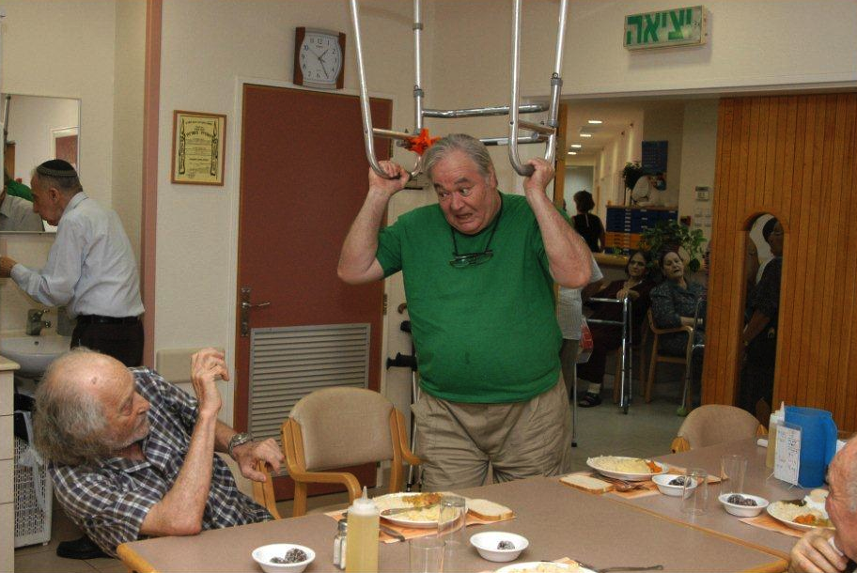
Interactions Between Residents in Long-term Care Homes
Permission to use the picture was received from JDC-ESHEL (Photographer Moti Fishbain)
Notes:
Say: Some of the most compassionate acts occur b/w people with dementia…both in the community and in LTC homes….
However, the flip side of it also occurs…
Direct care staff in nursing homes know for decades that these interactions can be very distressing and harmful to residents…and to themselves…

Slide 73
Public Health Problem
Shinoda-Tagawa et al. (2004). Resident-to-resident violent incidents in nursing homes. JAMA, 291(5), 591-598:http://jama.jamanetwork.com/article.aspx?articleid=198137
Caspi (2016). Deaths as a result of resident-to-resident altercations in dementia in LTC homes: A need for research, policy, and prevention. JAMDA, 17(1), 7-11: http://www.jamda.com/article/S1525-8610(15)00640-4/pdf
Notes:
We have strong evidence to suggest that these resident-to-resident incidents can be injurious and even fatal…
But…
[DASHAL: ADD MY PARAGRAPH FROM MY EDITORIAL ON RUNNING THE RISK OF STIGNITIZING AS DANGEROUS]

Slide 74
Old culture
Resident-to-Resident…
“Abuse” (“Abusive”)
“Mistreatment”
“Violence” (“Violent”)
“Aggression” (“Aggressive”)
“Perpetrator”
Suggestion: Describe what you see w/o labeling…
Notes:
Describe exactly what you see: Hitting, kicking, pushing, scratching…
State Operations Manual: “Noting that the resident is generally “violent,” “agitated” or “aggressive” does not identify the specific behavior exhibited by the resident. Noting instead that the resident responds in crowded, busy group activities by yelling or throwing furniture reflects not only a potential safety issue but should result in the resident being provided alternative activities to meet his/her needs.”
Perpetrator. In most situations…especially in the mid-to-late stages of dementia, the term “Perpetrator” is inappropriate, misleading, and often harmful…
It is easy for caring professionals to forget that individuals exhibiting these behavioral expressions have a profound brain disease…

Slide 75
Expert’s Opinion
“If I have one message about dementia-related behavior, it is: Assume people are scared. They live in a world that doesn’t make sense to them. They don’t know who to trust and they are looking for reassurance that they are in the right place, doing the right thing, and that someone knows how to find them. That explains a lot of the dementia-related behaviors. If you think about that each time you see someone who looks like they are behaving uncharacteristically or aggressively, you’ll do fine.”
– Prof. Lisa Gwyther, Duke University
Source: HealthCare Interactive® CARES Online Dementia Training
Notes:
Source: HealthCare Interactive®. CARES: Online Dementia Training. Dementia Basics and Advanced Care. Module 3: Understanding Behavior as communication.

Slide 76
New Culture
Distressing and harmful resident-to-resident Interactions in dementia in LTC homes
“Fighting for Dignity”
Notes:
I prefer the word “Interactions” = Distressing and Harmful Resident-to-Resident Interactions.”
When we focus closely on the interactions, without judgment, we are in a much better position to identify what are the unmet human needs and frustrations that underlie many of these episodes…
“Fighting for Dignity” – This is what is usually the real story behind what is commonly termed “aggressive behaviors” in this population.
+
Dignity (definition): “The quality or state of being worthy, honored, or esteemed.” (Webster Dictionary)
More often than not, these incidents develop when residents’ dignity is violated and when their human needs are not met in time…

Slide 77
Quote
“Be responsive to what their needs might be. It’s all about our approach.
It isn’t us.
It isn’t them.
It’s about their needs.”
– Director of Recreation Therapies

Slide 78
In research…
“Case” / “Subject”
“I am not a case” – Person with dementia
Consider…
“Research Participant”
“We call them participants, not subjects.”
– Dr. John Morris
Notes:
In one conference, a person living with dementia stood up and said: “I am not a case.”
Dr. John Morris: “We call them participants, not subjects.”
…
NEXT 4 SLIDES = LAST 4 ENDING QUOTES…

Slide 79
End Quote I
“Until we find a cure, our family will fight for Nanny because underneath the shell of memory loss, the confusion, and the sadness, there is a person with a heart that will always remember. What I found most helpful when taking care of Nanny was remembering that while she would yell at us or be hurt that we could not stay with her forever, it wasn’t her real self reacting. We try to remember that Alzheimer’s disease takes people’s lives away and the unfamiliar person we see is just as unfamiliar to them. I can only hope that doctors, researchers, and caregivers can do everything in their power to make the disease more bearable, if they are unable to find a cure.”
– Erin Bryant, granddaughter of an older woman in mid-stage Alzheimer’s disease

Slide 80
End Quote II
“People with dementia may have something important to teach the rest of humankind.
If we make the venture one of genuine and open engagement, we will learn a great deal about ourselves“
– Professor Tom Kitwood, author of the groundbreaking book: Dementia Reconsidered: The Person Comes First (1997)

Slide 81
End Quote III
“Alzheimer’s disease doesn’t take away the person’s dignity. We do.”
– Joanne Koenig Coste, author of the book (2003) Learning to Speak Alzheimer’s: A groundbreaking approach for everyone dealing with the disease
Notes:
“Alzheimer’s disease doesn’t take away the person’s dignity. [PAUSE for 2 seconds] We do.” – Koenig Coste

Slide 82
End Quote IV
“PLEASE CHOOSE THE WORDS YOU USE CAREFULLY SO AS NOT TO DIMINISH OR DEVALUE ANY PERSON WHO IS LIVING WITH DEMENTIA.”
– Dementia Action Alliance White Paper Words Matter
Notes:
Add: “This will give them the opportunity to live their lives to the fullest despite substantial cognitive disabilities.” Thank you!

Slide 83
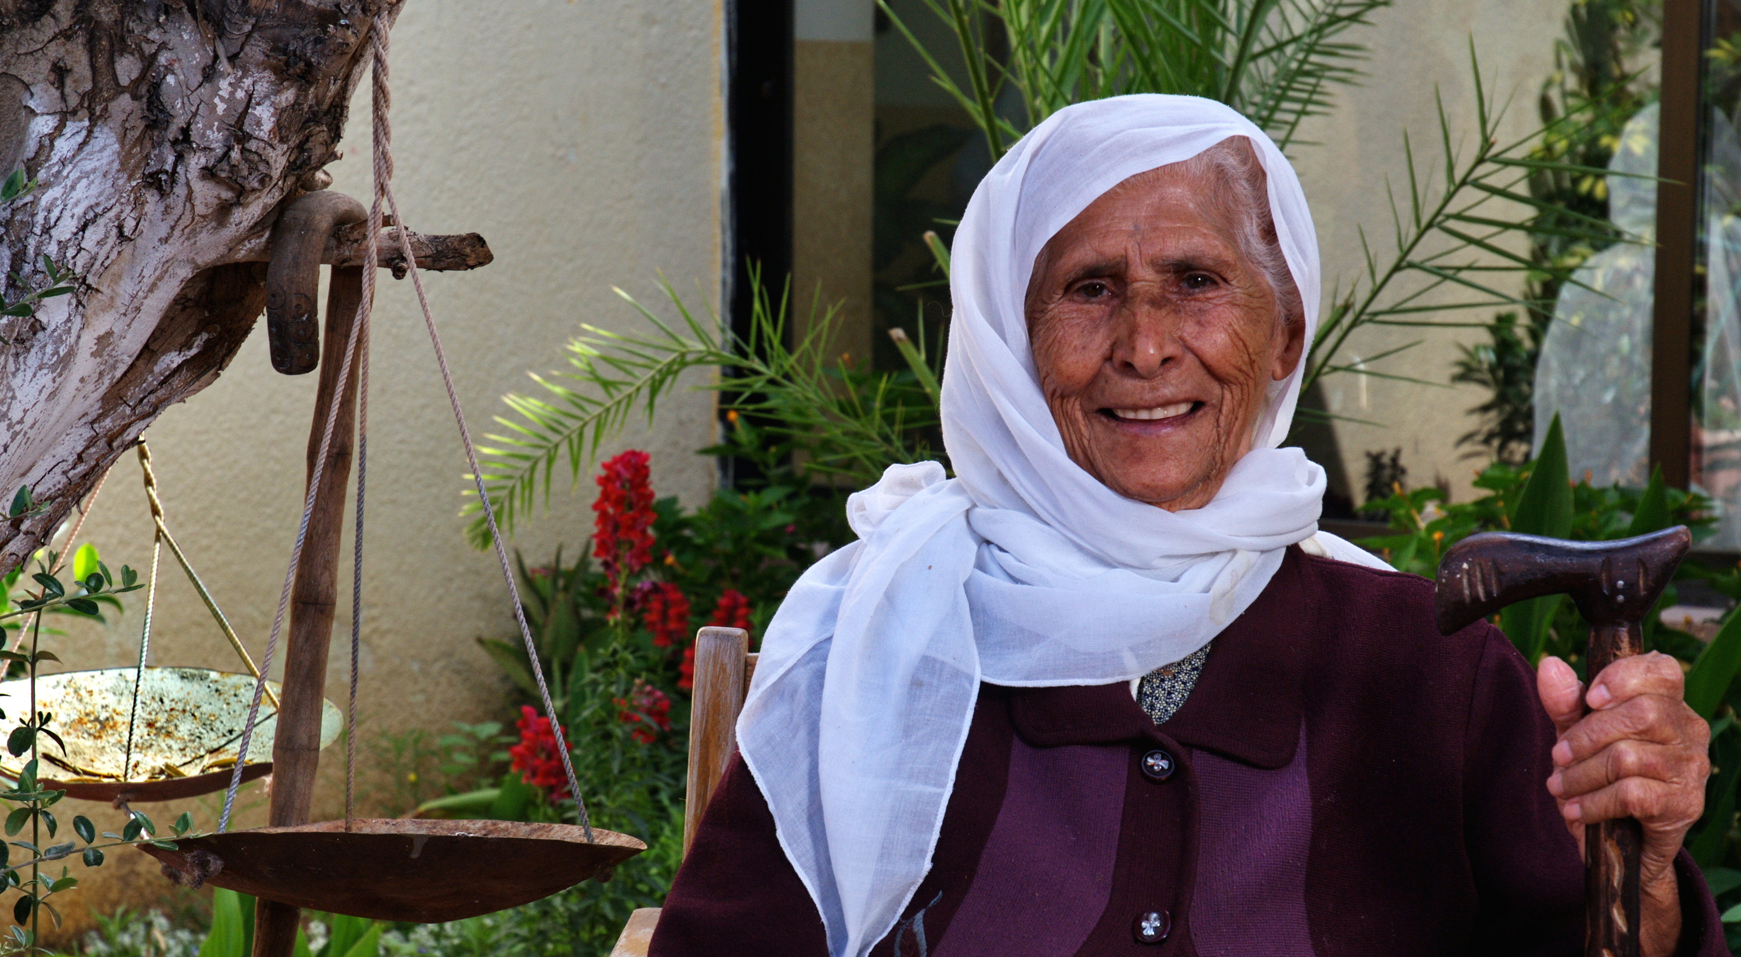
Questions / Discussion
Permission to use this image was received from Ofir Ben Natan, ESHEL, Israel
Notes:
We’ll open for discussion, comments, and questions…
I hope to learn from you about how all this plays out among Veterans with dementia!

Slide 84
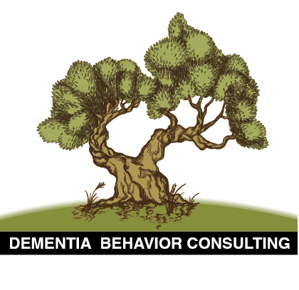
Contact Information
Email: eiloncaspi@gmail.com
Website: http://dementiabehaviorconsulting.com

Slide 85
Resources
Alzheimer’s Australia – Dementia Language Guidelines:
https://www.fightdementia.org.au/files/NATIONAL/documents/language-guidelines-full.pdf
Caspi, E. (2013). Time for change: Persons with dementia and “behavioral expressions,” not “behavior symptoms.” JAMDA, 14(10), 768-769.
Caspi, E. (2013) Old vs. New Language in Care of Elders with Memory Loss: A Collection of Contrasting Quotes:

Slide 86
Resources
Palmore, E. (2000). Guest Editorial: Ageism in Gerontological Language. The Gerontologist, 40(6), 645.
Pinkowitz, J. & Love, K. (eds). 2015. Living Fully with Dementia: Words Matter. White Paper. Dementia Action Alliance. Falls Church, VA:
http://daanow.org/wp-content/uploads/2015/01/Living-Fully-with-Dementia-Words-Matter_9.9.2015.pdf
Power, G.A. (2015). Medicalization of Feelings: BPSD or BPSOD? http://changingaging.org/dementia/medicalization-of-feelings-bpsd-or-bpsod/

