Slide 1
HealthLinks and Primary Care Collaborative Ontario’s Best Practice Exchange Catalyst Event
Rural Kingston
Sept 25, 2015
James Chau, FP & Annie Campbell, RN
Notes:
Mary starts

Slide 2
Acknowledgements
Mary Woodman
David Harvey
Kathy Hickman

Slide 3
Learning Objectives
Move toward a shared understanding of what Coordinated Care is and why it is a beneficial person-centred practice.
Explore ways to begin to use/enhance use of Coordinated Care Plans in Primary Care and Health Links for older adults with complex care needs due to mental health, substance use, dementia or other neurological conditions.
Begin to identify best practices for making sure that Coordinated Care Planning is person and family-centred.

Slide 4
Intro and context
HealthLinks is a provincial initiative with 69 HLs to date
Aligned with the Minister’s action plan “Patients First”
It is an approach or process, not an organization
Notes:
Mary

Slide 5
Goals of Health Links
better outcomes for patients / families
improved patient experience (and provider experience)
reduced utilization of hospitals to lower overall cost

Slide 6
HealthLinks: a new philosophy and approach
HL is all about improving quality of care
We know we can do better.
We need to address the fact that a very few people – 5% of the population is using 66% of the health budget.
We need to re-design care for those patients
At the patient level and at the system level
This represents big change for providers

Slide 7
Integration & Coordination of Care
Requires integration at the system level
Integrating sectors and organizations across the continuum of care
Improved collaboration between health and social service providers
Requires coordination of care at the patient level
HealthLinks will begin by focusing on the patients who have the most complex needs: high medical and high social needs
Notes:
We are all being asked to integrate and coordinate our health and social services
Integration and coordination require collaboration with each other – with our patients and between organzations.
Reference the Alberta Health Services document on Integrated Care

Slide 8
Target populations
“Complex” as defined by MOH
4+ co-morbidities/conditions
Unmet social needs
Overlay of hospital utilization
Sub –populations
Frail and elderly needs
End of life needs
Addictions & Mental Health needs

Slide 9
Objectives
When?
Coordinated Care
What?
Who?
Why?
Where?

Slide 10
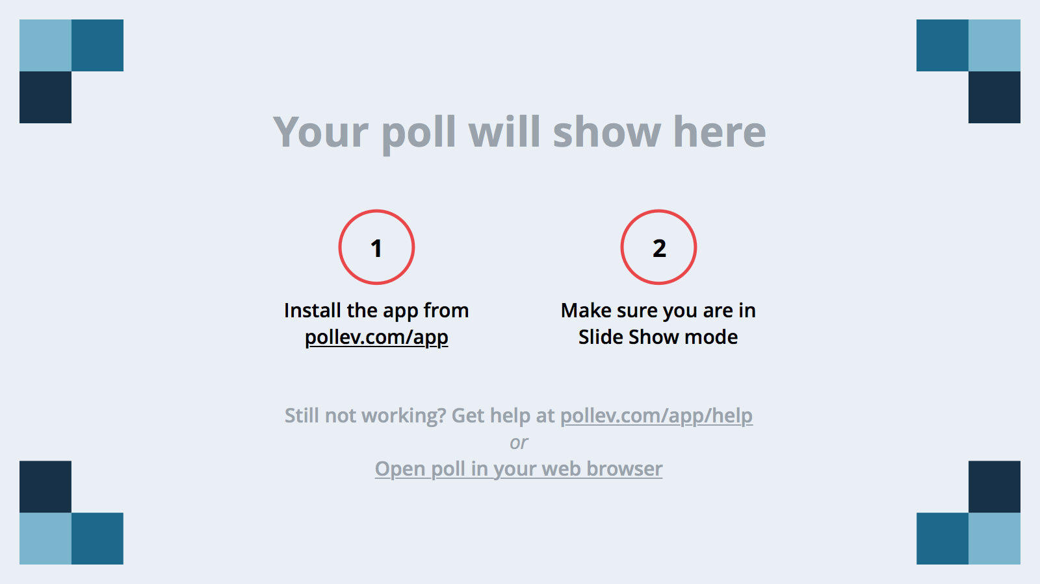
Notes:
Poll Title: How would you describe the current state of mental health care services for the elderly? https://www.polleverywhere.com/free_text_polls/Fb0gm6XkJ0WdlB1

Slide 11
Medications
Health Issues
Specialized Dementia Unit
BSO
Primary Care
Person
Alzheimer Society
Family
Caregiver
Emergency
CCAC
Long Term Care
Seniors Mental Health
Specialized Geriatric Services
Notes:
Indeed, the term “coordinated care” is used simultaneously and
interchangeably to conceptualize structural aspects of care delivery (i.e., what
care is provided and when); the process of care delivery (i.e., how care is
delivered); the philosophical aspects of care delivery (i.e., why care is
delivered in a particular manner); and the interpersonal aspects of care
delivery (i.e., who delivers care to whom).

Slide 12
Notes:
Poll Title: What does Coordinated Care mean to you? https://www.polleverywhere.com/free_text_polls/ofrl66yZ2FCEZAi

Slide 13
Coordinated Care
Client
Service Delivery
System
Notes:
Client: a. Person-centred care
b. Identification of a target group with complex needs and
undertaking holistic health, social and risk assessments
c. Relevant and shared care planning
d. Regular reassessment, monitoring and review
e. Engagement with clients and caregivers to support self-management
Service Delivery:
A cooperative multidisciplinary primary care team with a clearly
identified coordinator and defined team roles
b. Communication processes that facilitate timely interactions
among all care partners – including clients and families
c. Learning communities among health care providers
d. Evidence based policies, guidelines and protocols
e. Flexible care provision
System:
Effective resource coordination including fund pooling and the
involvement of senior and middle management
b. Mechanisms for efficient and effective transfer of synchronized
information across settings, between clinicians, and between
clinicians and clients
c. Integrated networks of organizations that include linkages
between all components of the system.
d. Collaboration among elements of the system.

Slide 14
Core Competencies Required for Care Coordination
Philosophy or values consistent with this approach
True patient centred care; QI
Exemplary communication skills
Interview skills for difficult conversations
Counselling skills
Facilitation skills – aid in transitions and meetings
Networking & Navigation skills
Linkages to community resources
Advocacy role
Analytical skills
Ability to determine needs and gaps in care
Flexibility
Notes:
Source: Ehrlich, C. et al. “Coordinated Care: what does that really mean?” Paper prepared as part of a primary health care research collaboration between Griffith University and General Practice Queensland.

Slide 15
Coordinated Care – Primary Care

Slide 16
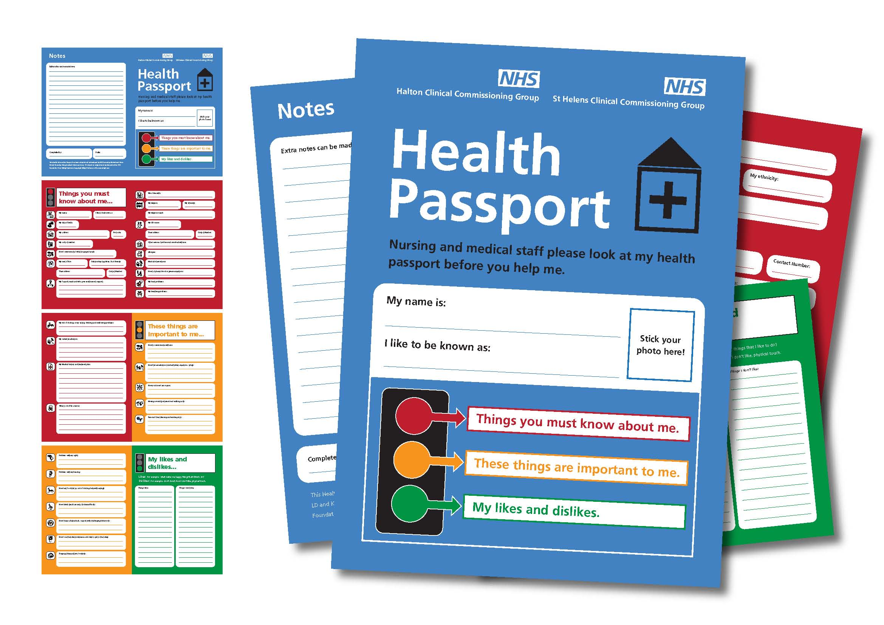

Slide 17
Coordinated Care

Slide 18
Health Link CCP Process
Identify
Invite
Co create CCP
Action the Plan
Maintenance
“Short time span of intensive care coordination”

Slide 19
Coordinated Care Plans and Guiding Principles
A CCP must be a reflection of the patients voice
This is not a medical visit or nursing assessment
Patient Advisory Committee members suggest:
“Ask for my opinion”
“Speak in plain language”
“Be honest about my prognosis”
Do not label me with “dementia” on front page
Do not TELL me what I need – just ASK me!

Slide 20
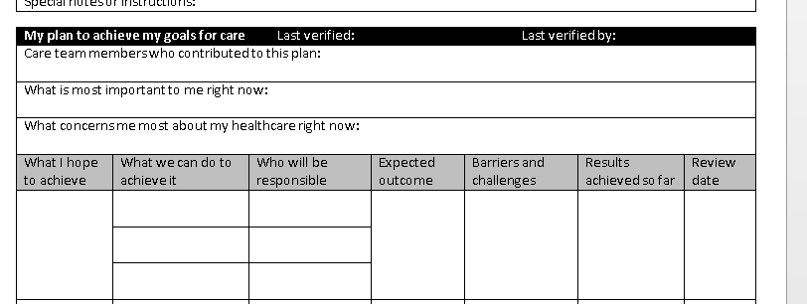
Provincial Health Link Coordinated Care Plan
Notes:
Highlight some points of overlap

Slide 21
Case Study
Walk through CCP
People involved, services involved, time
Engage client, family, POA or trusted friend
Parkinson’s ; fearful of memory loss, general anxiety re health, and spouses health ; including burden on her.
Confused and frustrated that specialists do not see me as a person.

Slide 22
What made the difference?
What was different with this approach to care?
Interview with patient & family?
Having them co-design care?
Working with community partners?
Case conferencing to identify needs and resolve issues?

Slide 23
Discussion/ Questions
What do you think about the HealthLinks Coordinated Care Plan?
What do you like?
How could the way it’s used be improved to better meet the needs of older adults with complex care needs due to mental health, substance use, dementia or other neurological conditions?
How could this tool or parts of it be used in your setting to improve care & service?
How can we make sure Coordinated Care Planning is person and family-centred?

Slide 24
Next Steps/Future Directions
Surface other processes and tools for Coordinated Care Planning
Continue to build the resource bank
Review and summarize key elements/success factors of various coordinated care planning processes and tools
Begin to identify best practices for making sure that Coordinated Care Planning is person and family-centred.

Slide 25
For more information:
Annie Campbell….
Dr Laurel Dempsey
Lori Van Manen , QI facilitator
James Chau
David Harvey

